Slide 1
Save Gas Map
Problem description
To identify the shortest path for a given set of addresses and display them on the map
Team Members:
Raghuveer Raghavendra
Prasanna Jeevan

Slide 2
Implementation details
Features
Takes Input of multiple locations
Finds the shortest distance between all the locations (Using a heuristic algorithm for TSP)
Arranges the locations into a optimal route
Displays the location on Google map
Major classes used are Android Location, Maps and Overlay

Slide 3
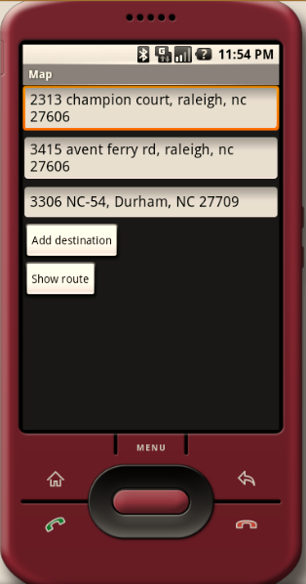
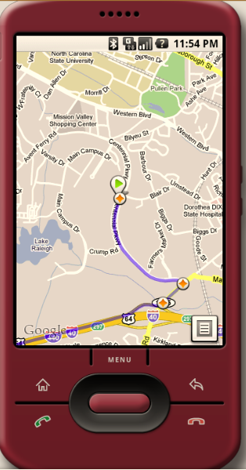
Snapshots

