Slide 1
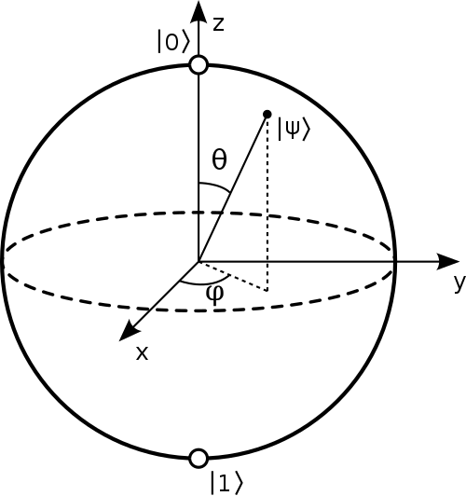
Quantum Gates,
Circuits, and Algorithms
Quantum Computing– Fall 2020

Slide 2
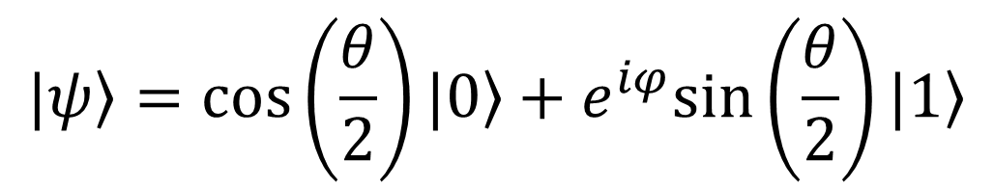
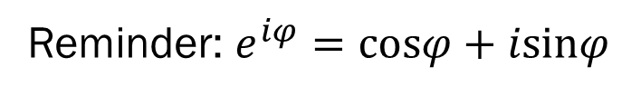
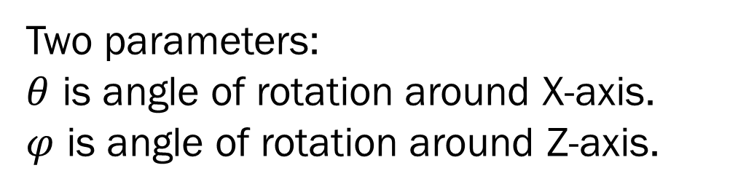
Bloch Sphere Representation
$$|ψ〉=cos\left(\frac{θ}{2}\right)|0〉+e^{iφ}sin\left(\frac{θ}{2}\right)|1〉$$
Two parameters:
$θ$ is angle of rotation around X-axis.
$φ$ is angle of rotation around Z-axis.
Reminder: $e^{iφ}=cosφ+isinφ$
https://en.wikipedia.org/wiki/Bloch_sphere

Slide 3
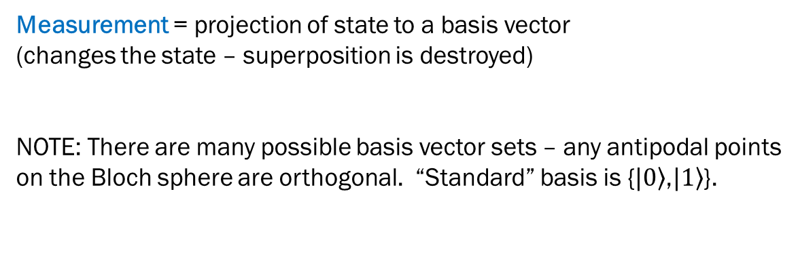
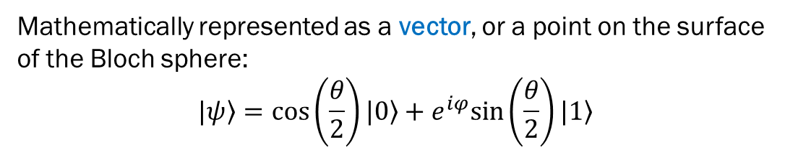
Quantum State (qubit)
Mathematically represented as a vector, or a point on the surface
of the Bloch sphere:
$$|ψ〉=cos\left(\frac{θ}{2}\right)|0〉+e^{iφ}sin\left(\frac{θ}{2}\right)|1〉$$
Measurement = projection of state to a basis vector
(changes the state – superposition is destroyed)
NOTE: There are many possible basis vector sets – any antipodal points
on the Bloch sphere are orthogonal. “Standard” basis is {$|0〉$,$|1〉$}.
https://en.wikipedia.org/wiki/Bloch_sphere

Slide 4
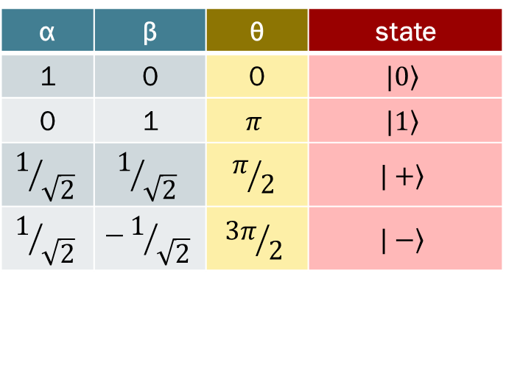
Quantum State (qubit)
Mathematically represented as a vector, or a point on the surface
of the Bloch sphere:
$$|ψ〉=cos\left(\frac{θ}{2}\right)|0〉+e^{iφ}sin\left(\frac{θ}{2}\right)|1〉$$
α | β | θ | state
1 | 0 | 0 | $$|0〉$$
0 | 1 | $$π$$ | $$|1〉$$
$$1/{\sqrt{2}}$$ | $$1/{\sqrt{2}}$$ | $$π/2$$ | $$|+〉$$
$$1/{\sqrt{2}}$$ | $$−1/{\sqrt{2}}$$ | $${3π}/2$$ | $$|−〉$$
https://en.wikipedia.org/wiki/Bloch_sphere

Slide 5
Quantum Gate
Quantum gate is a transformation from one qubit state to another.
Single-qubit gate = rotation around Bloch sphere. Reversible.
Represented by a (unitary) matrix acting on the vector.
https://en.wikipedia.org/wiki/Bloch_sphere

Slide 6
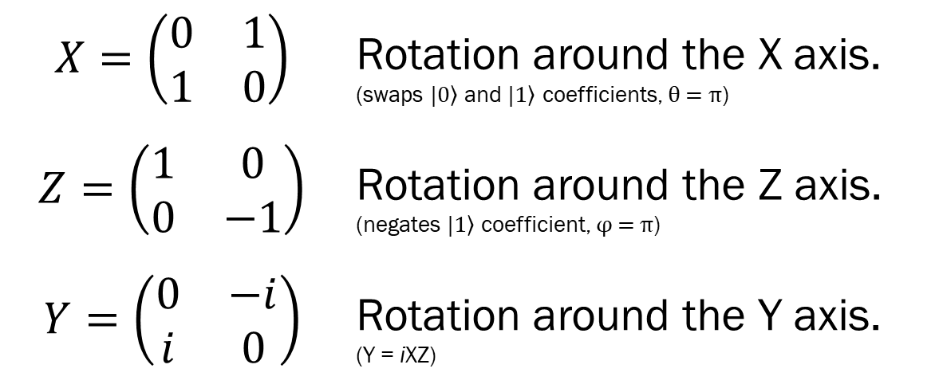
Some Unitary Transformations
 | Rotation around the Y axis. (Y = iXZ)
Pauli matrices

Slide 7
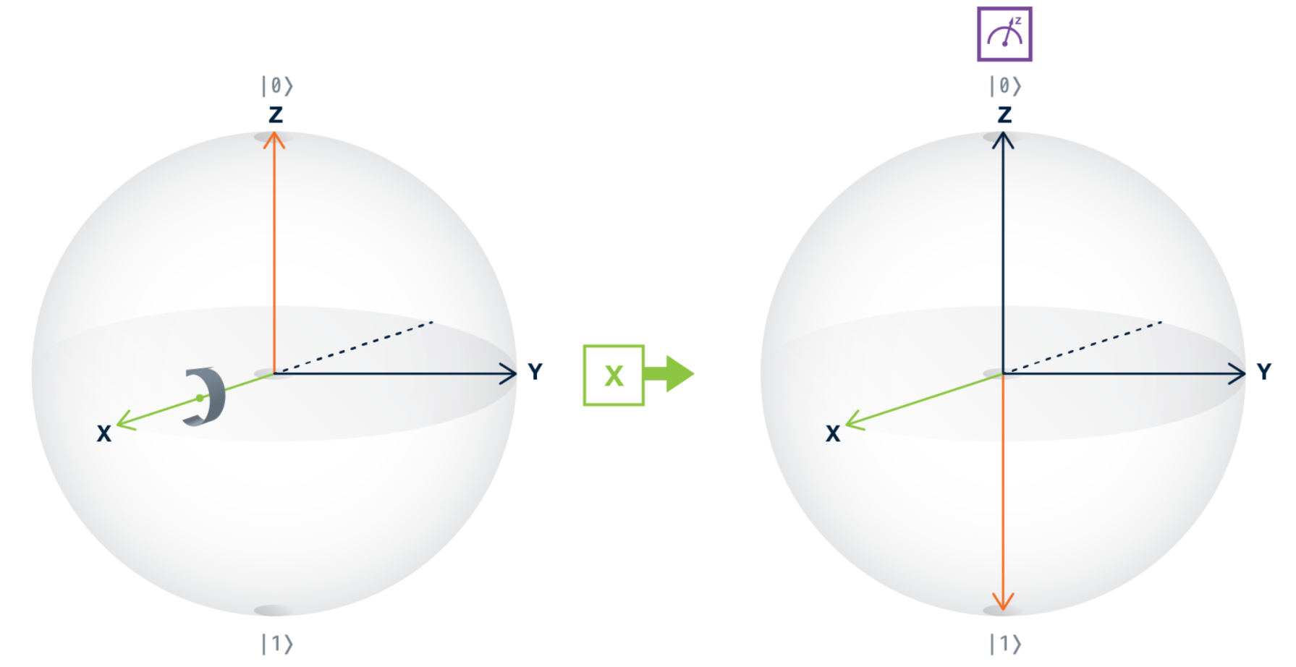

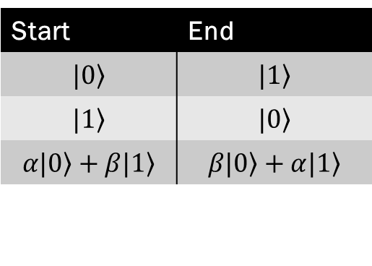

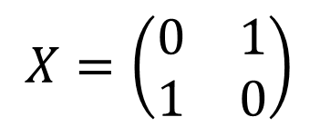
X Gate: NOT
Start | End
$$|0〉$$ | $$|1〉$$
$$|1〉$$ | $$|0〉$$
$$α|0〉+β|1〉$$ | $$β|0〉+α|1〉$$
$$X=\left(\begin{matrix}0 & 1 \\ 1 & 0\end{matrix}\right)$$
rotate by π
around the X axis
$$X|0〉=\left(\begin{matrix}0 & 1 \\ 1 & 0\end{matrix}\right)\left(\begin{matrix}1 \\ 0\end{matrix}\right)=\left(\begin{matrix}0 \\ 1\end{matrix}\right)$$
Quirk demo:
https://algassert.com/quirk

Slide 8
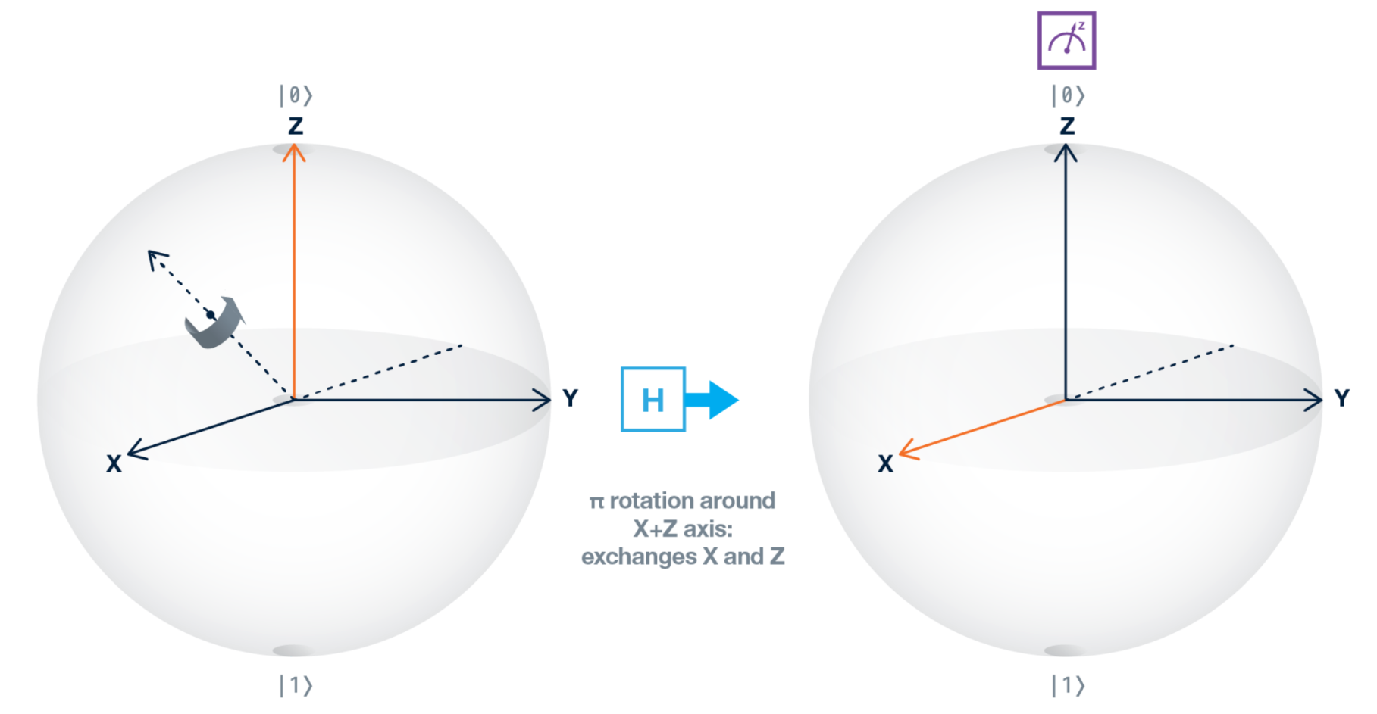
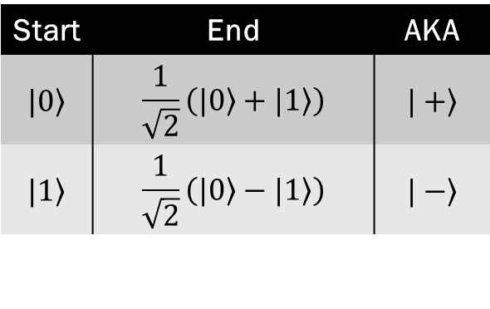
Hadamard (H) Gate: Superposition
Start | End | AKA
$$|0〉$$ | $$\frac{1}{\sqrt{2}}\left(|0〉+|1〉\right)$$ | $$|+〉$$
$$|1〉$$ | $$\frac{1}{\sqrt{2}}\left(|0〉−|1〉\right)$$ | $$|−〉$$
π Rotation around (X+Z)/√2-axis
Also equivalent to 2 rotations:
around Z-axis + π/2 around Y-axis
Or:
π/2 around X-axis + π/2 around Z-axis

Slide 9
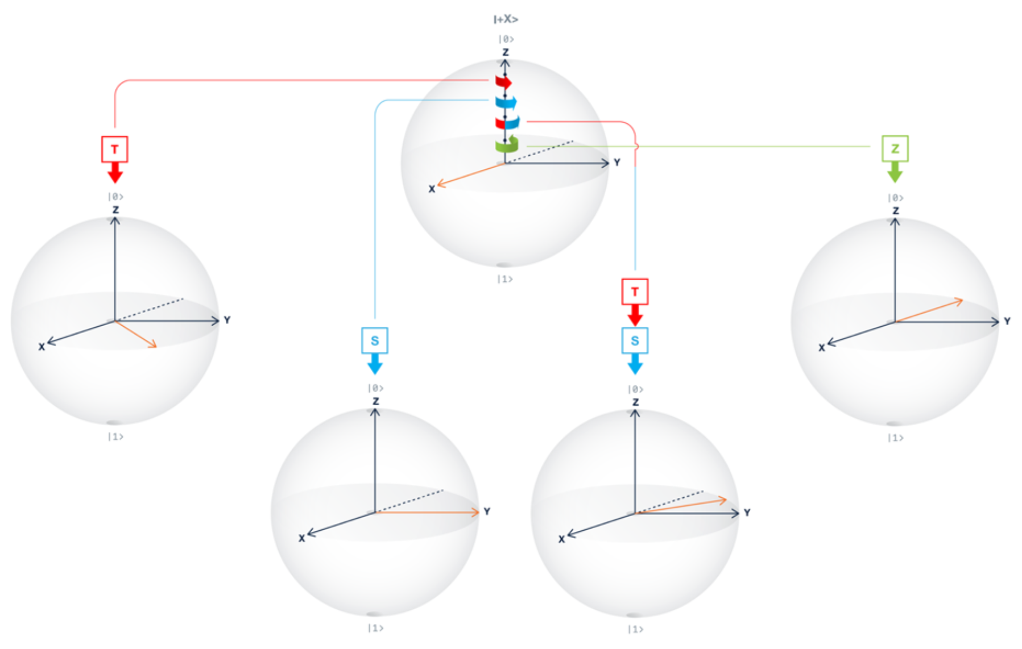
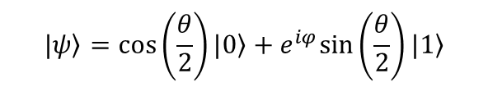
Phase: Z, S, T
Rotations around the Z axis
T = π/4
S = π/2
Z = π
$$|ψ〉=cos\left(\frac{θ}{2}\right)|0〉+e^{iφ}sin\left(\frac{θ}{2}\right)|1〉$$
Quirk demo:
https://algassert.com/quirk

Slide 10
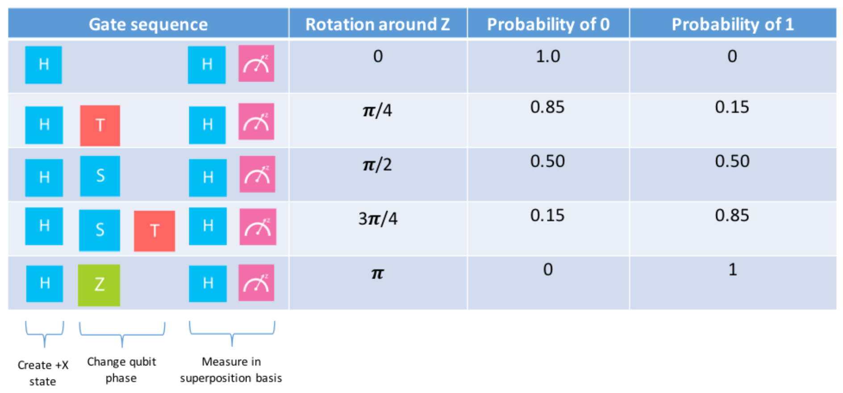
Phase: Z, S, T

Slide 11
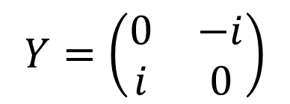
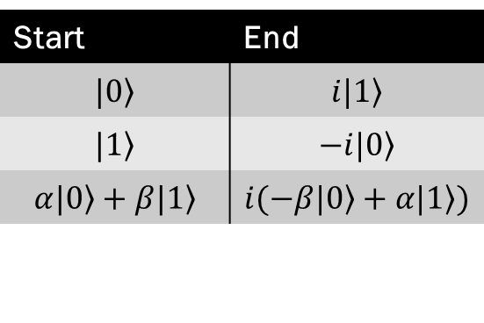
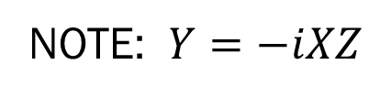

Y Gate
Start | End
$$|0〉$$ | $$i|1〉$$
$$|1〉$$ | $$−i|0〉$$
$$α|0〉+β|1〉$$ | $$i(−β|0〉+α|1〉)$$
$$Y=\left(\begin{matrix}0 & −i \\ i & 0\end{matrix}\right)$$
rotate by π
around the Y axis
$$Y|0〉=\left(\begin{matrix}0 & −i \\ i & 0\end{matrix}\right)\left(\begin{matrix}1 \\ 0\end{matrix}\right)=\left(\begin{matrix}0 \\ i\end{matrix}\right)$$
NOTE: $Y=−iXZ$

Slide 12
Rotational Gates
rotate by θ
around the X axis
rotate by θ
around the Y axis
rotate by θ
around the Z axis

Slide 13
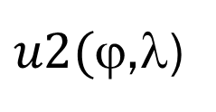
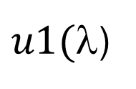
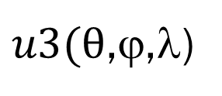
U Gates: u1, u2, u3
The most general unitary gate
IBM Gate
Used to generate…
$u3(θ$,ϕ,λ)
$u1($λ)
T, T†, S, S†, Z
$u2($ϕ,λ)
H = u2(0,π)

Slide 14
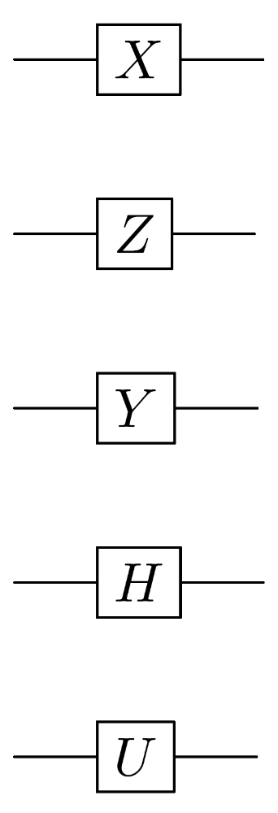
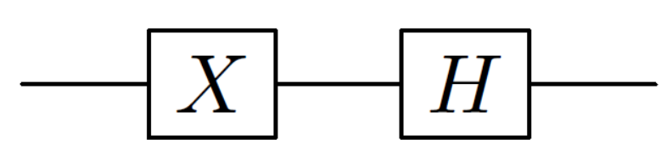
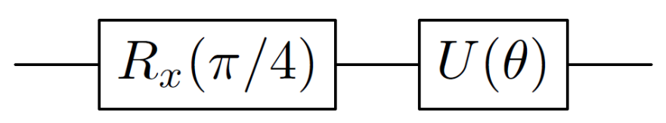
Quantum Gates: Circuit

Slide 15
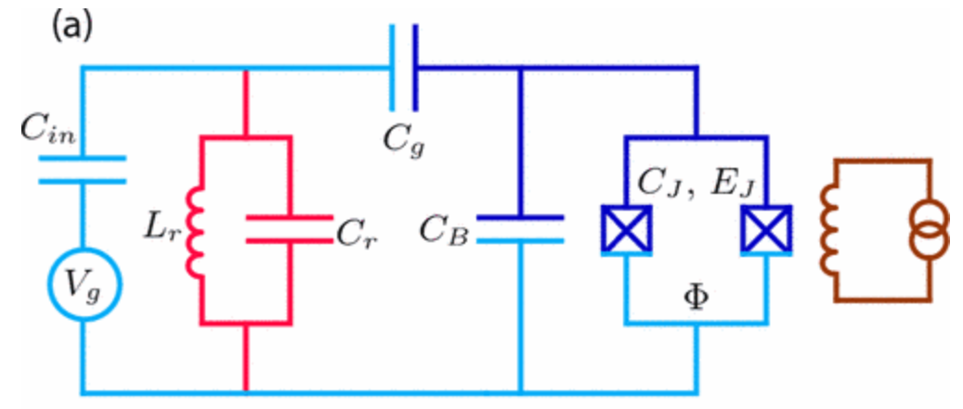
A word about implementation…
Quotes from IBM Q material
The qubit we use is a fixed-frequency superconducting transmon qubit. It is a Josephson-junction-based qubit that is insensitive to charge noise.
The devices are made on silicon wafers with superconducting metals such as niobium and aluminum.
Quantum gates are performed by sending electromagnetic impulses at microwave frequencies to the qubits through coaxial cables. These electromagnetic pulses have a particular duration, frequency, and phase that determine the angle of rotation of the qubit state around a particular axis of the Bloch sphere.
Koch, et al.
Phys. Rev. A 76, 042319 –Oct 2007

Slide 16
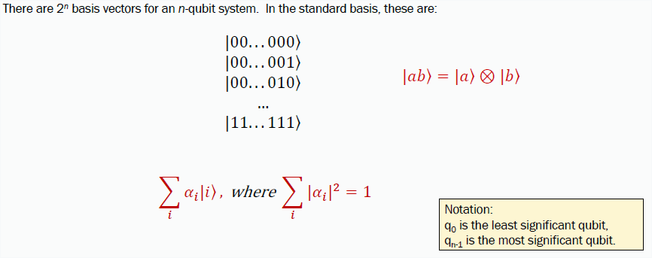
Multi-Qubit States

Slide 17
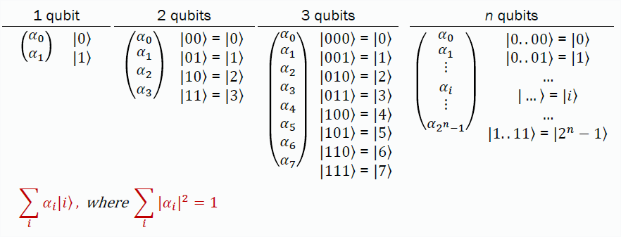
Multi-Qubit States

Slide 18
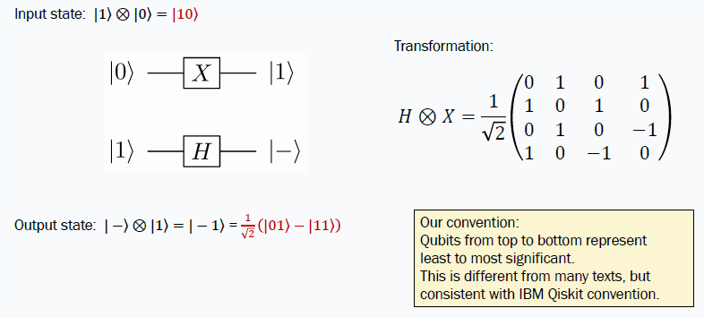
Two-qubit System Example

Slide 19
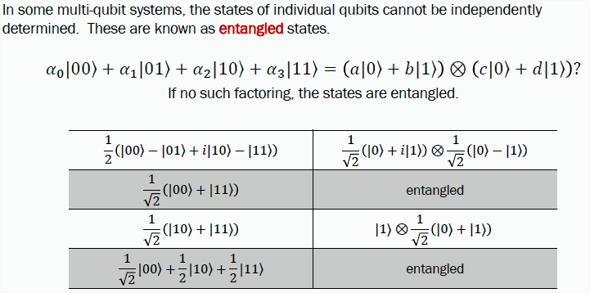
Entagled States
i

Slide 20
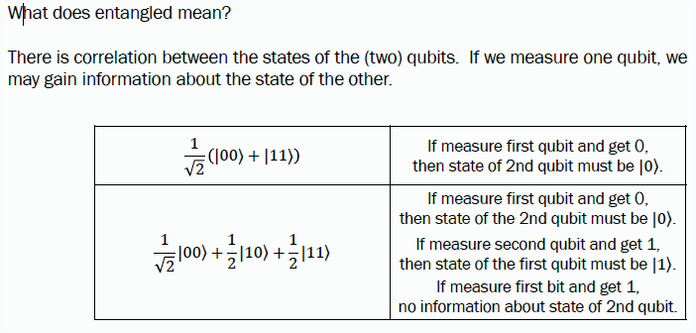
Entagled States

Slide 21
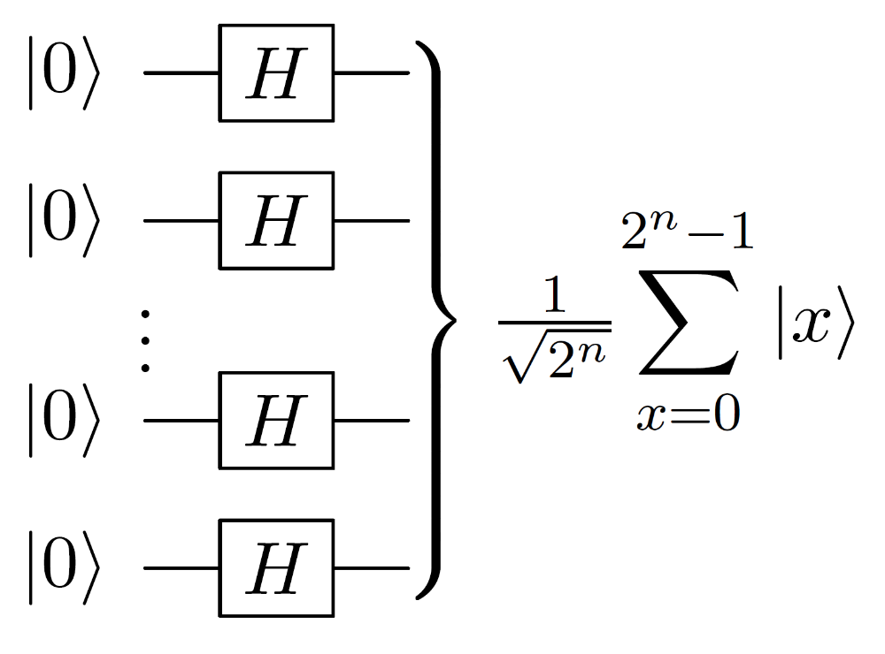
Walsh-Hadamard Transform
Used in the setup phase of
algorithms, to create a
superposition of all inputs.
Transformations occur on all
components of the superposition.
This is the source of quantum
parallelism.
This is not an entangled state.

Slide 22
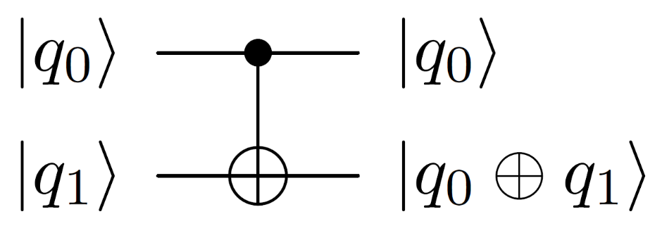
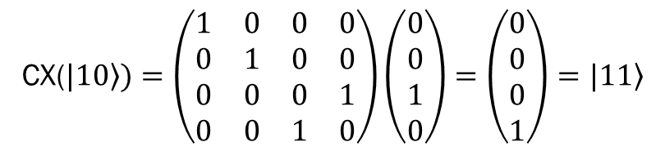
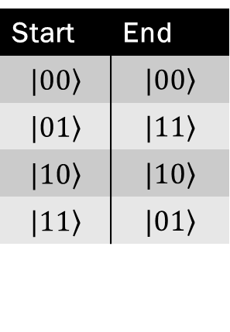
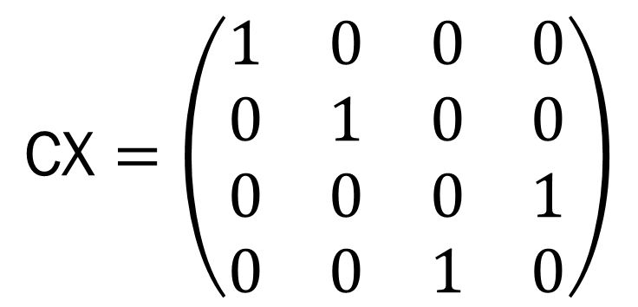
Two-qubit Gate: CNOT
IBM notation: <q₁q₀|
most textbooks: <q₀q₁|
$$\text{CX}=\left(\begin{matrix}1 & 0 & 0 & 0 \\ 0 & 1 & 0 & 0 \\ 0 & 0 & 0 & 1 \\ 0 & 0 & 1 & 0\end{matrix}\right)$$
Start | End
 | |01>
 | |11>
 | |10>
CNOT = controlled-NOT = CX
If q₀ = 1, flip q₁.
Start | End
Be careful about notions of “control” and “target.”
More about this later…

Slide 23
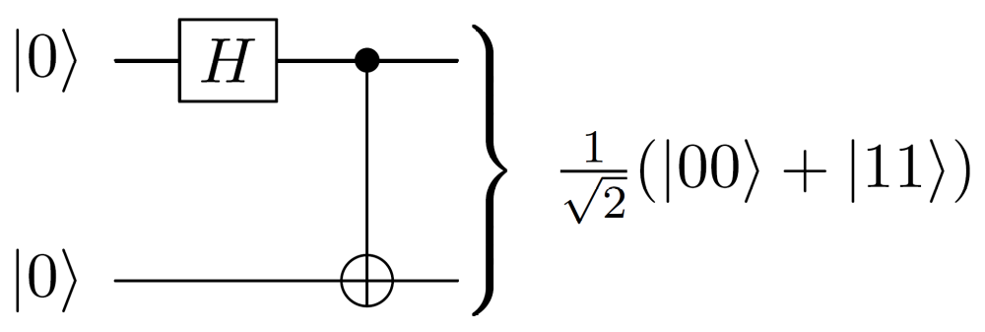
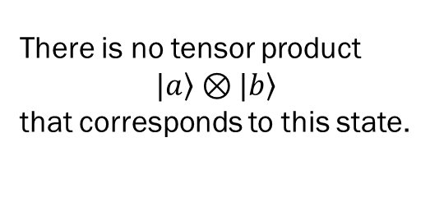
Two-qubit Gate: CNOT
CNOT = controlled-NOT
Entanglement: Bell Pair
Start | End
$$|00〉$$ | $$|00〉$$
$$|01〉$$ | $$|11〉$$
$$|10〉$$ | $$|10〉$$
$$|11〉$$ | $$|01〉$$
There is no tensor product
$$|a〉⊗|b〉$$
that corresponds to this state.
Be careful about notions of “control” and “target.”
More about this later…

Slide 24
CNOT with Superposition
Notice: IBM notation of |q₁q₀>
In general, CNOT is an entangling operation.

Slide 25
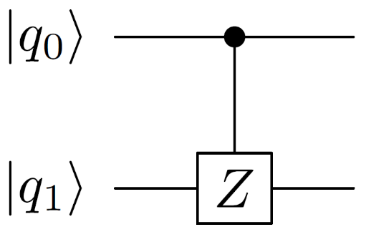
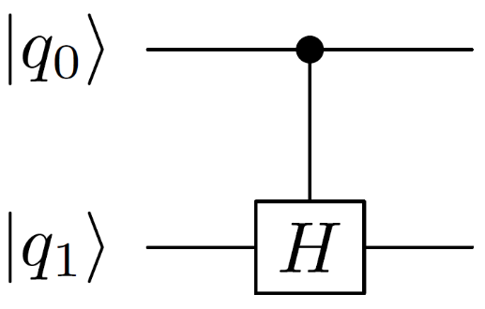
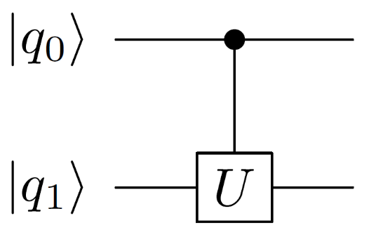
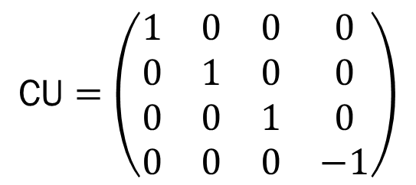
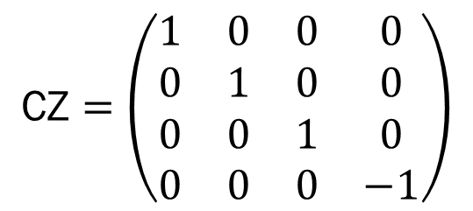
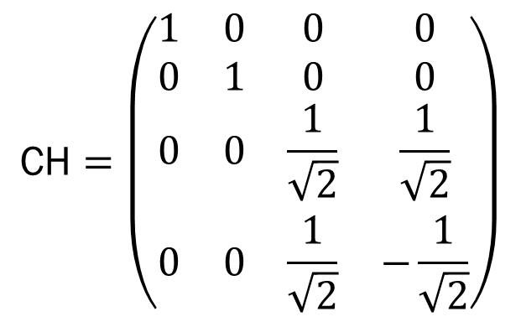
Generalized Control Gates
CZ = controlled-Z
CH = controlled-H
CU = controlled-U
$$\text{C}\text{H}=\left(\begin{matrix}1 & 0 & 0 & 0 \\ 0 & 1 & 0 & 0 \\ 0 & 0 & \frac{1}{\sqrt{2}} & \frac{1}{\sqrt{2}} \\ 0 & 0 & \frac{1}{\sqrt{2}} & −\frac{1}{\sqrt{2}}\end{matrix}\right)$$
$$\text{C}\text{U}=\left(\begin{matrix}1 & 0 & 0 & 0 \\ 0 & 1 & 0 & 0 \\ 0 & 0 & 1 & 0 \\ 0 & 0 & 0 & −1\end{matrix}\right)$$
$$\text{C}\text{Z}=\left(\begin{matrix}1 & 0 & 0 & 0 \\ 0 & 1 & 0 & 0 \\ 0 & 0 & 1 & 0 \\ 0 & 0 & 0 & −1\end{matrix}\right)$$
U

Slide 26
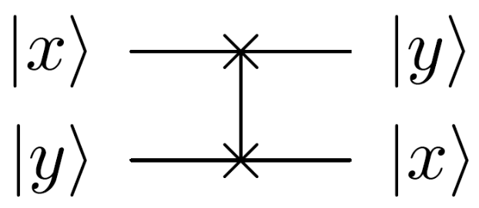
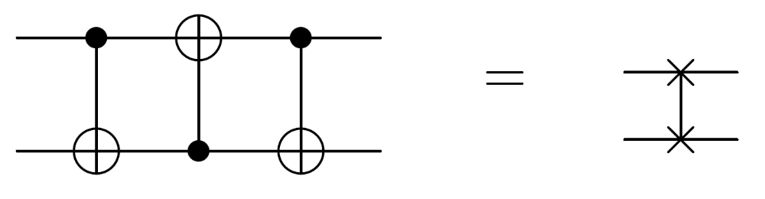
Other Two-Bit Gates (IBM Qiskit)
controlled Pauli gates (X, Y, Z) – controlled X is CNOT
controlled Hadamard gate
controlled rotation gates (Rx, Ry, Rz)
controlled phase gate (u1)
controlled u3 gate
swap gate

Slide 27
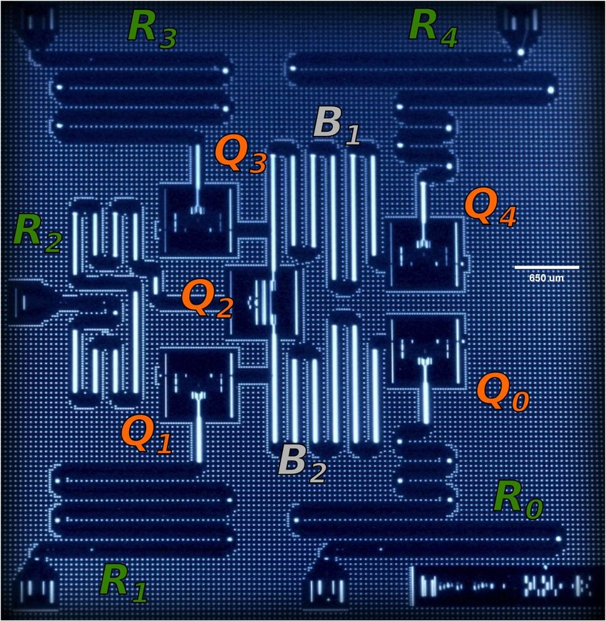
A word about implementation…
Quotes from IBM Q material
Two-qubit gates typically require tuning to calibrate the interaction between the two qubits during the gate duration, and minimizing the interaction at any other time. Since our qubits of choice are fixed-frequency transmons, we cannot tune the interaction by bringing them closer in frequency during the two-qubit gate. Instead, we exploit the cross-resonance effect, by driving one of the qubits (called control) with a microwave pulse tuned at the frequency of the second qubit (called target). By doing this, we can actively increase the strength of the coupling between them. The nature of the cross-resonance effect also allows us to perform rotations in the target qubit conditioned on the state of the control qubit, a key characteristic of the CNOT operation required for a universal quantum gate set.
Hegade, et al. arXiv:1712.07326v1, 9 Jul 2018.

Slide 28
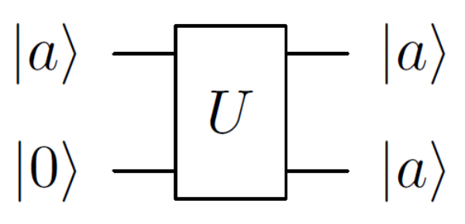
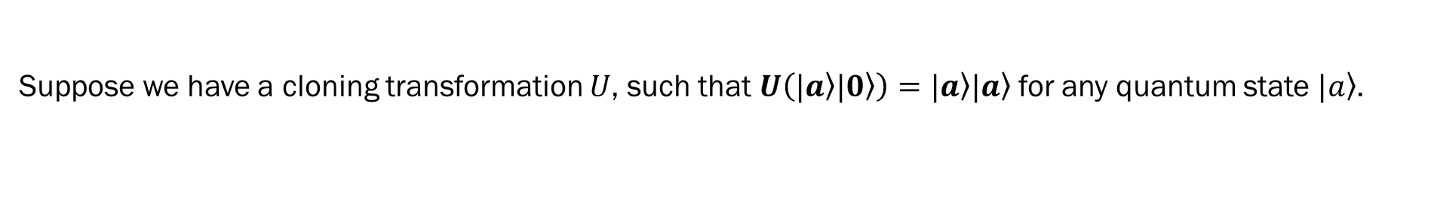
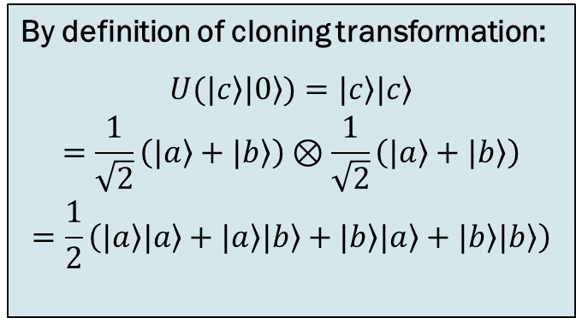


No-Cloning Principle (revisited)
Suppose we have a cloning transformation $U$, such that $U\left(|a〉|0〉\right)=|a〉|a〉$for any quantum state $|a〉$.
Let $|a〉$ and $|b〉$ be two orthogonal quantum states. Therefore,
$$U\left(|a〉|0〉\right)=|a〉|a〉$$
$$U\left(|b〉|0〉\right)=|b〉|b〉$$
Consider $|c〉=\frac{|a〉+|b〉}{\sqrt{2}}$.
By definition of cloning transformation:
$$\begin{matrix}U(|c〉|0〉)=|c〉|c〉 \\ =\frac{1}{\sqrt{2}}\left(|a〉+|b〉\right)⊗\frac{1}{\sqrt{2}}\left(|a〉+|b〉\right) \\ =\frac{1}{2}\left(|a〉|a〉+|a〉|b〉+|b〉|a〉+|b〉|b〉\right)\end{matrix}$$
By linearity:
$$\begin{matrix}U(|c〉|0〉)=\frac{1}{\sqrt{2}}\left(\left.U(|a〉|0〉)+U(|b〉|0〉\right)\right) \\ =\frac{1}{\sqrt{2}}\left(|a〉|a〉+|b〉|b〉\right)\end{matrix}$$
≠
These are not equal ⇒ there is no $U$ for which both can be true.

Slide 29


Three-qubit Gates
Toffoli: controlled CNOT
Fredkin: controlled swap
These are not implemented directly on the IBM Q. They are built from 1- and 2-qubit gates.

Slide 30

Toffoli Gate
$$\text{Toffoli}=\left(\begin{matrix}1 & 0 & 0 & 0 & 0 & 0 & 0 & 0 \\ 0 & 1 & 0 & 0 & 0 & 0 & 0 & 0 \\ 0 & 0 & 1 & 0 & 0 & 0 & 0 & 0 \\ 0 & 0 & 0 & 1 & 0 & 0 & 0 & 0 \\ 0 & 0 & 0 & 0 & 1 & 0 & 0 & 0 \\ 0 & 0 & 0 & 0 & 0 & 1 & 0 & 0 \\ 0 & 0 & 0 & 0 & 0 & 0 & 0 & 1 \\ 0 & 0 & 0 & 0 & 0 & 0 & 1 & 0\end{matrix}\right)$$

Slide 31




Toffoli: Reversible Classic Gates
NOT
AND
NAND
XOR

Slide 32

Quantum Circuit
Measurement.
Double line represents classical bit.
Standard Circuit Model
CNOT plus all single-bit transformations
Measurement in the standard basis
Any quantum transformation can be realized
in terms of the basic gates of the standard
circuit model.
Time flows left to right.
Quantum gates (operators) are applied sequentially
to qubit states, with result shown on the right.

Slide 33



Example Circuit: Half Adder
a | b | sum | carry
0 | 0 | 0 | 0
0 | 1 | 1 | 0
1 | 0 | 1 | 0
1 | 1 | 0 | 1
Using the standard basis states $|0〉$ and $|1〉$, this is a binary half adder.
What if the input qubits are general?
What if input is $|+000〉$? What would you expect if you measure all output qubits?

Slide 34


What about superposition?
NOT THIS
THIS
entangled
Note: ignoring normalizing coefficients.

Slide 35



Caution 1: Phases
Quantum state transformations are specified in terms of actions in the vector space,
not in terms of quantum state. (There’s a difference.) Example – consider the controlled phase shift:
$|10〉$ and $e^{iθ}|10〉$ represent exactly the same state.
So is this equivalent to the identity transformation? No.
$$\frac{1}{\sqrt{2}}\left(|00〉+|11〉\right)→\frac{1}{\sqrt{2}}\left(|00〉+e^{iθ}|11〉\right)$$
These are different states due to the relative phase.
$$\begin{matrix}|00〉→|00〉 \\ |01〉→|01〉 \\ |10〉→e^{iθ}|10〉 \\ |11〉→e^{iθ}|11〉\end{matrix}$$
Rieffel and Polak, 2014.

Slide 36



Caution 2: Notion of Control
The notions of control and target bit is a carryover from the classical gate, and should not be taken too literally. Do not conclude that the control bit is never changed.
Consider the CNOT gate operating in the Hadamard basis:
Start | End
$$|++〉$$ | $$|++〉$$
$$|+−〉$$ | $$|−−〉$$
$$|−+〉$$ | $$|−+〉$$
$$|−−〉$$ | $$|+−〉$$
In this case, it’s the first qubit that changes.

Slide 37



Caution 3: Reading Circuit Diagram
The graphical representation of a circuit can be misleading. Must “do the math” and figure out exactly what transformation is happening, even if all qubits are in the standard basis.
What is the output of the following circuit?
Because the H gate is its own inverse, you might think that the first qubit will be unchanged.
But the output is $\frac{1}{2}\left(|00〉+|01〉+|10〉−|11〉\right)$ -- not obvious from the diagram.

