Slide 1
Solving the Optimal Trading Trajectory Problem Using a Quantum Annealer
Gili Rosenberg, Poya Haghnegahdar, Phil Goddard, Peter Carr, Kesheng Wu, and Marcos Lopez de Prado

Slide 2
Objective
Give a brief introduction to the portfolio optimization problem
Give a brief introduction to quantum annealing
Illustrate how the portfolio optimization problem can be solved on the D-Wave's quantum annealer
Look at the experimental results
Describe the problems faced and the limitations of the work
Think about whether it makes sense to actually execute real life problems on the D-Wave, based on the experimental results obtained

Slide 3
Portfolio Optimization
Process of selecting the best portfolio out of multiple portfolios, according to some objective
Objective typically involves maximizing expected return and minimizing risk
Constrained utility-maximization problem
NP-complete problem
Central to the solution of this problem is the construction of a covariance matrix

Slide 4
Crux of the Problem
Asset manager wants to invest K dollars in a set of N assets with an investment horizon divided into T time steps
  Asset manager has to decide how much to invest in each asset at each time step
  Has to take into account transaction costs, and the behavior of the market

Slide 5
Solution
Compute the portfolio that maximizes the return subject to a level of risk at each time step
  Results in a series of statically optimal portfolios
  Cost of rebalancing from a portfolio that is locally optimal at t to a portfolio that is locally optimal at t+1
  Might result in the formulation of a less optimal portfolio than the globally optimal portfolio
Traditionally solved as continuous-variable problems
However for large assets, a discrete solution yields better results

Slide 6

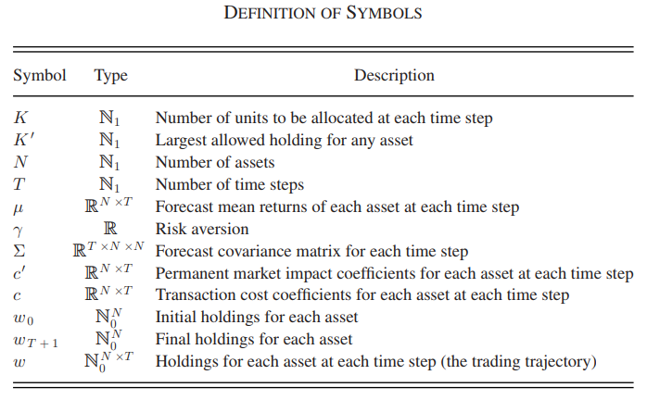



Definition of Symbols

Slide 7
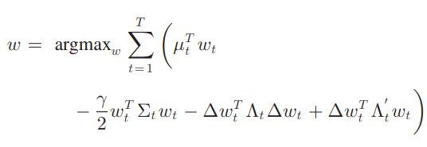
Integer Formulation
The first term is the sum of the returns at each time step, which is given by the forecast returns μ times the holdings w. The second term is the risk, in which the forecast covariance tensor is given by Σ, and γ is the risk aversion. The third and fourth terms encapsulate transaction costs

Slide 8
What is Quantum Annealing
Way of using the intrinsic effects of quantum physics to solve
  Optimization Problems
    Find best configuration amongst many possible configurations
    Can be represented as an energy minimization problem
  Probabilistic Sampling
    Related to optimization problems
    Instead of finding minimum energy state, sample many low energy states to characterize the shape of energy landscape

Slide 9
Use of Quantum Annealers
Quantum Annealers
are designed to solve certain problems
using a quantum annealing algorithm
that belongs to the adiabatic quantum model of computation
and is implemented in hardware that exploits quantum properties

Slide 10
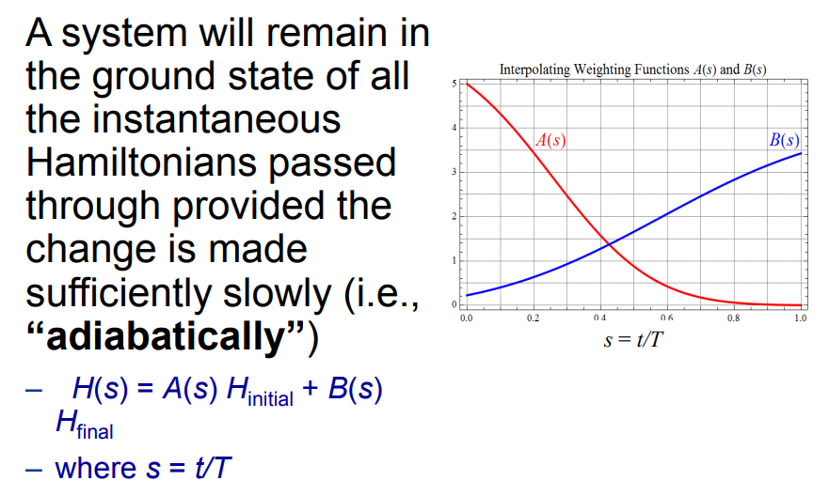
Adiabatic Quantum Optimization Perspective
Slide taken from Joel Gottlieb's talk: Introduction to the Physics of D-Wave and Comparison to the Gate Mode

Slide 11
Adiabatic Quantum Computation
Steps for adiabatic quantum computation
First, a Hamiltonian is found whose ground state describes the solution to the problem of interest
Then, a system with a simple Hamiltonian is prepared and initialized to the ground state
Finally the simple Hamiltonian is adiabatically evolved to the desired complicated Hamiltonian

Slide 12
D-Wave Quantum Annealer
Device which minimizes unconstrained binary quadratic functions
Cooled to 15 mK to keep disturbances at a minimum
Shielded from RF signals
Shielded from external magnetic fields larger than 1 nT
Operates in a high vacuum environment

Slide 13
D-Wave application flow
Recast variables in original problem as binary variables
Convert to Quadratic Unconstrained Binary Optimization (QUBO)
Solve QUBO with qbsolv
Convert bit vector back to variables in problem domain
Interpret qbsolv results and adjust accordingly
Steps taken from Joel Gottlieb's talk: Driving to the 48 USA State Capitals: Programming the D-Wave QPU

Slide 14
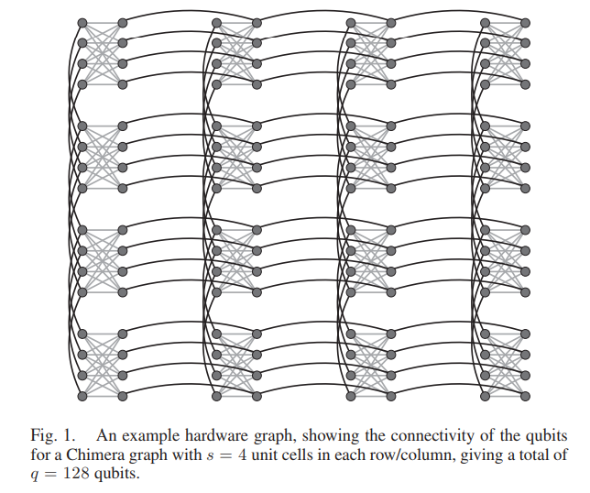
Chimera Graph

Slide 15
Chimera Graph(contd.)
Describes the connectivity of D-Wave's quantum annealer
Sparsely connected graph with a well-defined structure of edges
For square Chimera hardware graphs, the size V of the largest fully dense problem that can be embedded on a chip with q qubits is V = √2q +1=4s + 1, where s is the number of unit cells along an edge
To solve problems that are denser than the hardware graph, multiple physical qubits are identified with a single logical qubit, at the cost of using many more physical qubits

Slide 16
From Integer to Binary
To solve the optimization problem on the Quantum annealer, the variables in the equation given on slide 8 have to be recast as binary variables
Four different encodings investigated for the purpose:
  Binary - representation of symbols in a source alphabet by strings of binary digits
  Unary - representation a natural number, n, with n ones followed by a zero
  Sequential - approximate decoding algorithm for long constraint-length convolutional codes
  Partitioning – find all partitions of K into N assets, and assign a binary variable to each encoding at each time step

Slide 17
Binary Encoding
Number of variables required to represent a particular problem is T*N*log2(K' + 1)
Largest integer that can be represented is [2n] - 1
Most efficient in number of variables
Allows representation of the second-lowest integer
Requires the least number of variables
Most sensitive to noise

Slide 18
Unary Encoding
Number of variables required to represent a particular problem is T*N*K'
No limit on the largest integer that can be represented
Biases the quantum annealer due to differing redundancy of code words for each value
Encoding coefficients are even, giving no dependence on noise, so it allows representing of the largest integer
Requires the second largest number of variables

Slide 19
Sequential Encoding
Number of variables required to represent a particular problem is ½*T*N*(√(1+8K') − 1)
Largest integer that can be represented is ½*[n]*([n] + 1)
Biases the quantum annealer (but less than unary encoding)
Second-most-efficient in number of variables
Allows representing of the second-largest integer

Slide 20
Partition Encoding
Number of variables required to represent a particular problem is less than or equal to T*(K+N-1) or T*(N-1)
Largest integer that can be represented is [n]
Can incorporate complicated constraints easily
Least efficient in number of variables
Only applicable for problems in which groups of variables are required to sum to a constant
Allows representing the lowest integer.

Slide 21
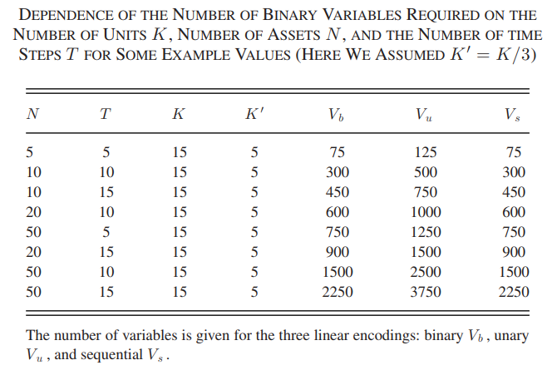
Number of Binary Variables Used
As we can see, unary encoding requires the maximum number of variables, compared to the other two encodings

Slide 22
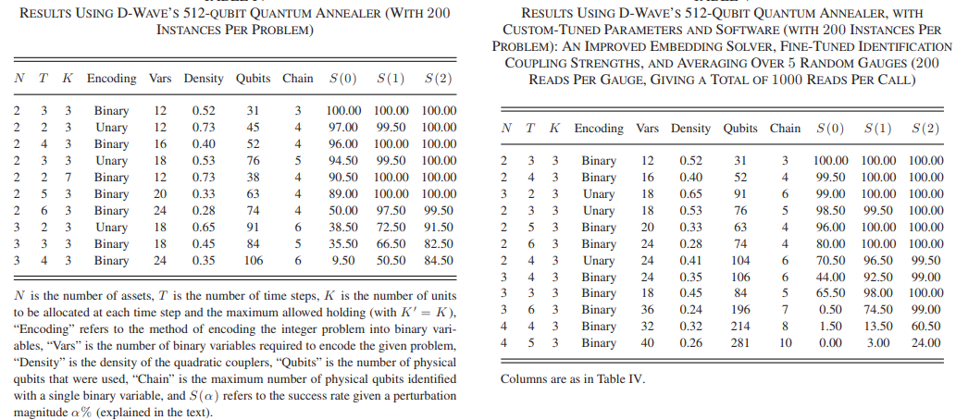
Results
Success rate increases while using 1Qbit's solver

Slide 23
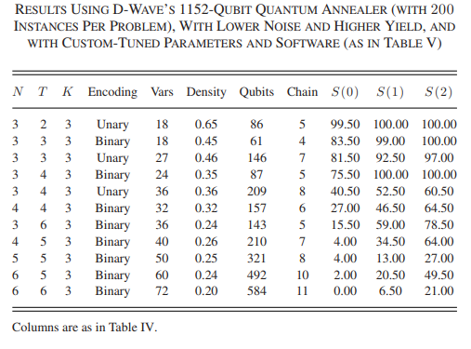
Results(contd.)
The 1152-Qubit Quantum Annealer has a higher success rate than the 512-Qubit Quantum Annealer

Slide 24
Success Rate
As a solution metric, the percentage of instances for each problem for which the quantum annealer’s result fell within perturbation magnitude α% of the optimal solution were used
The metric was evaluated by perturbing each instance at least 100 times, by adding Gaussian noise with standard deviation given by α% of each eigenvalue of the problem matrix Q
Each perturbed problem was solved by an exhaustive solver, and the optimal solutions were collected
If the quantum annealer’s result for that instance fell within the range of optimal values collected, then it was deemed successful

Slide 25
Problems
Level of intrinsic noise which manifests as a misspecification error
Coefficients of the problem that the quantum annealer actually solves differ from the problem coefficients by up to Ɛ. Problem coefficients on the chip have a defined coefficient range, and if the specified problem has coefficients outside this range, the entire problem is scaled down, resulting in coefficients becoming smaller than Ɛ, affecting the success rate

Slide 26
Problems(contd.)
To solve problems that are denser than the hardware graph, multiple physical qubits are identified with a single binary variable, at the cost of using more physical qubits
To force the identified qubits to all have the same value, a strong coupling is needed
More qubits needed, as more qubits would allow the use of an encoding scheme that is less sensitive to noise levels
Better error correction required

Slide 27
Speedup
There is an ongoing debate on how to define quantum speedup
For the small-scale problems solved in this study, the time to solution, on both classical hardware and using the quantum annealer, is COMPARABLE
Only after quantum speedup has been demonstrated for general problems, and specifically those requiring a high precision of couplings, is it expected that a quantum speedup for the optimal trading trajectory problem will be observed

Slide 28
Conclusion
Demonstrated the potential of D-Wave’s quantum annealer to achieve high success rates while solving the portfolio optimization problem
Possible to achieve a considerable improvement in success rates by finetuning the operation of the quantum annealer
Technological improvements in future generations of quantum annealers are expected to provide the ability to solve larger problems, and at higher success rates

