Slide 1
Quantum Machine Learning
Behnam Kia
NC State University
April 2018
Notes:
This is not a lecture, and the coronet is not all proven facts. Instead this is a presentation about my findings and interpretation of the papers and books I read in this field. The field is very fragmented and there are a lot of overhyped, but unproven claims. So I did my best to categorize the approaches, and list their shortcoming and weaknesses. Although I tried to be as objective as possible, at the end some part of my argument can be considered subjective and some might disagree with them.– Behnam Kia

Slide 2
What is Machine Learning?
Some tasks are hard, if not impossible, to be programmed into a computer.
  Example: How to distinguish a cat from a dog.
Instead, we let the computer (or machine) learn it by providing lots of training data.

Slide 3


(Supervised) Machine Learning
Instance-Based Learning
Feature 2
(Weight)
Feature 1 (Height)
For sake of simplicity and better visualization, each training point is presented as a data point in a feature space. Such feature based machine learning has been abandoned in many application, and modern deep learning is utilized instead.

Slide 4

(Supervised) Machine Learning
Instance-Based Learning
Feature 2
(Weight)
Feature 1 (Height)
Notes:
Now after training, the AI system is shown a new unknown animal. This unknown mystery animal is represented in the feature space with a red circuit with a question mark inside.

Slide 5
(Supervised) Machine Learning
Instance-Based Learning
Feature 2
(Weight)
Feature 1 (Height)
Notes:
The AI system can simply refer to its past experience, and observe that it has seen couple of cats before that were very “close” to this new animal. Therefore it makes this inference that this new animal is a cat. This technique is called K-nearest neighborhood (KNN). KNN is an instance based learning technique, because it directly uses the training instances in order to make a deduction.
An issue with KNN or similar instance-based learning techniques can be that they have to hold on to their training data. Such training data can be extremely large. Also for each inference they have to do a search mechanism in order to find close training instances.

Slide 6
(Supervised) Machine Learning
Instance-Based Learning
Feature 2
(Weight)
Feature 1 (Height)
Notes:
The AI system can simply refer to its past experience, and observe that it has seen couple of cats before that were very “close” to this new animal. Therefore it makes this inference that this new animal is a cat. This technique is called K-nearest neighborhood (KNN). KNN is an instance based learning technique, because it directly uses the training instances in order to make a deduction.
An issue with KNN or similar instance-based learning techniques can be that they have to hold on to their training data. Such training data can be extremely large. Also for each inference they have to do a search mechanism in order to find close training instances.

Slide 7
(Supervised) Machine Learning
Feature 2
(Weight)
Feature 1 (Height)
Notes:
As a matter of fact we do not necessarily need to keep the training data. We can see from the picture that a simple line can separate dogs from cats. And that all what we need to learn from the training data.

Slide 8
(Supervised) Machine Learning
Model-Based Learning
Dog
Feature 2
(Weight)
Cat
A Model
Feature 1 (Height)
Notes:
This line is a model that we derived from the training data. From now on, we can get rid of the training data, and keep this model instead. Above the line is dog, and below is cat.

Slide 9
(Supervised) Machine Learning
Model-Based Learning
Dog
Feature 2
(Weight)
Cat
A Model
Feature 1 (Height)
Notes:
Whenever AI system sees a new animal, it checks which side of the line this new data point is. The new animal in the picture is clearly a cat.

Slide 10
(Supervised) Machine Learning
Model-Based Learning
Dog
Feature 2
(Weight)
Cat
A Model
Feature 1 (Height)
Notes:
Whenever AI system sees a new animal, it checks which side of the line this new data point is. The new animal in the picture is clearly a cat.

Slide 11
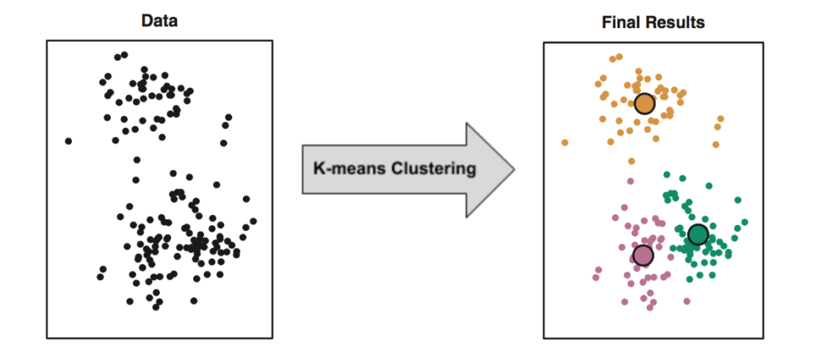
(Unsupervised) Machine Learning
Model-Based Learning
Picture from: Tibshirani, Robert, et al. "An introduction to statistical learning-with applications in R." (2013).
Notes:
Whenever AI system sees a new animal, it checks which side of the line this new data point is. The new animal in the picture is clearly a cat.

Slide 12
Machine Learning:
Needs and pain points

Slide 13
Machine Learning:
Needs and pain points
  Good Data!

Slide 14
Machine Learning:
Needs and pain points
  Good Data!
  Better Hardware (Power consumption, speed,…)

Slide 15
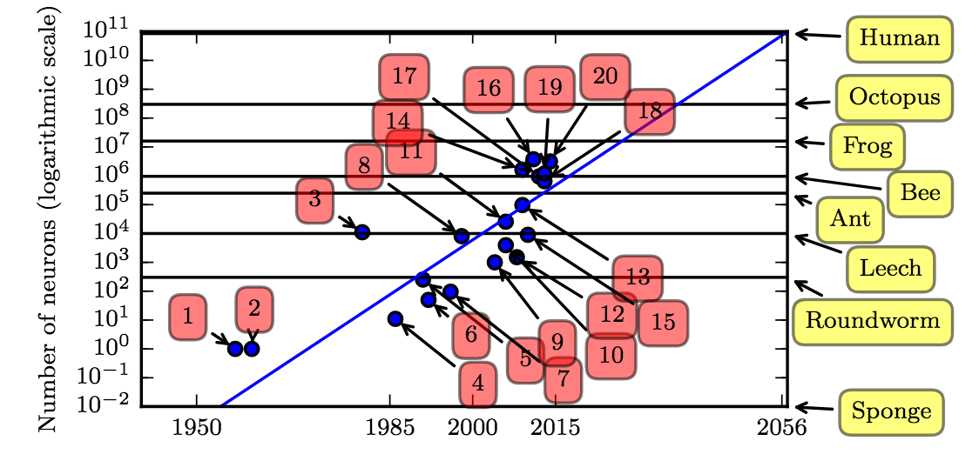
Picture from: Deep Learning, I. Goodfellow, et al.
20: GoogLeNet: Winning architecture on ImageNet 2014

Slide 16
Limitations of Conventional Hardware Technology
Moore’s Law (?)
Moore’s second law (economics): Costs of a new technology node is doubling.
Dennard scaling is dead.

Slide 17
New Architectures for Machine Learning
Same CMOS Technology, New Architectures
GPU
ASICs
FPGAs
Custom processors for deep learning, e.g. Google’s TPU

Slide 18
Beyond CMOS
Superconducting Computing
Memristors
Stochastic and Chaotic Computing
Quantum Computing
…

Slide 19
Quantum Computing
We have seen three sets of algorithms:
  Shor’s algorithm for factorizing, exponentially faster.
  Grover’s algorithm for finding an item in an unsorted array. Quadratically faster.
  Adiabatic Quantum Computing (Quantum annealing) for optimization problems. Speed up unknown (if any?)

Slide 20
Quantum Machine Learning
  Grover based algorithms:
    To measure min/max/mean distance or other metrics between data points.
    Exam: Clustering, K-NN, etc.
    Quadratically faster.
  Quantum basic linear algebra subroutines :
    Exponentially faster. (?)
  Adiabatic Quantum Computing (Quantum Annealing):
    For optimization.
    Speed up unknown (if any?)

Slide 21
Grover based algorithms for Quantum Machine Learning
f
x
f(x)

Slide 22

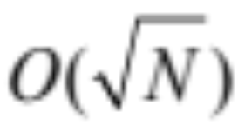
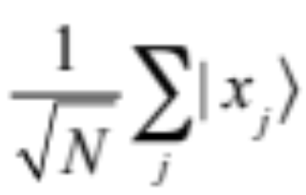
Grover algorithm
f is a black box function, mapping x to f(x).
X is a discrete set, and contains N elements.
Problem Definition: Find x that results in a particular output
Classic Algorithm: O(N)
Grover Algorithm:
f
x
f(x)

Slide 23
Grover algorithm, qRAM version
The black box can be a memory, a quantum memory!
f
x
f(x)

Slide 24
Random Access Memory
2^{n} cells, each m bits
Address Register
(n bits)
Output Register
(m bits)

Slide 25
Quantum Random Access Memory (qRAM)
2^{n} cells of m bits
(or m qubits)
Address Register
(n qubits)
Output Register
(m qubits)

Slide 26
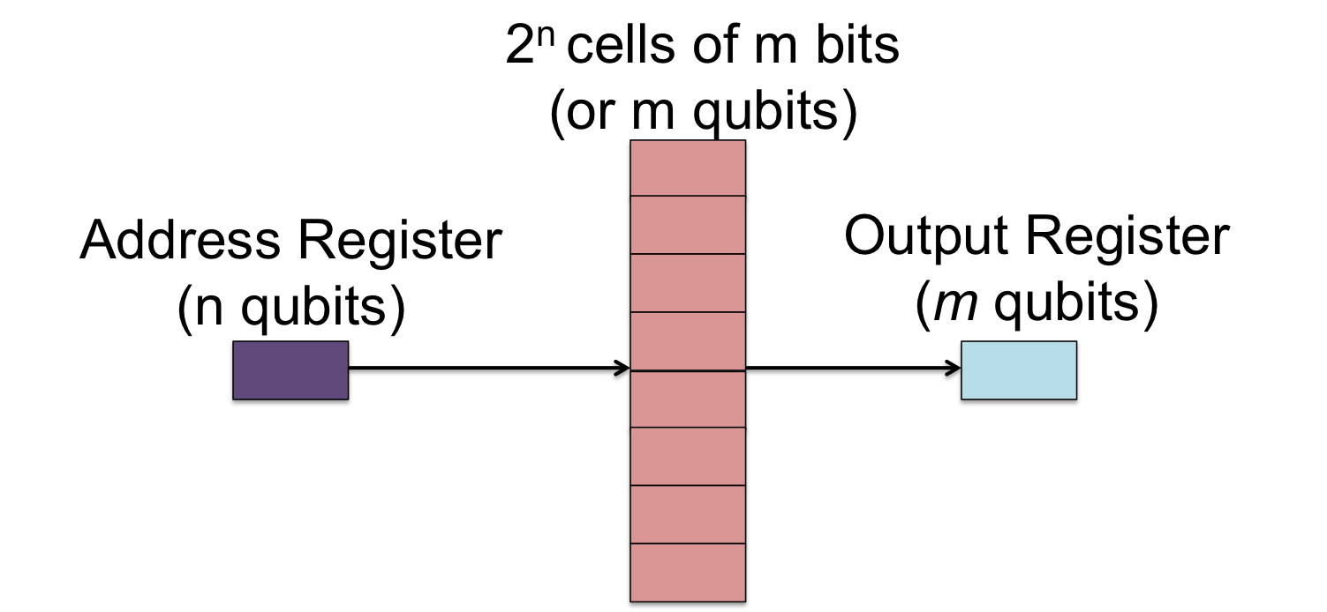
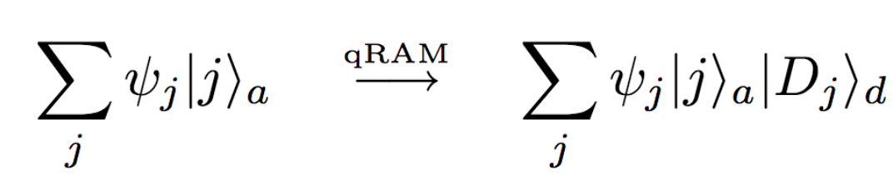
Quantum Random Access Memory
The qRAM can perform memory accesses in coherent quantum superposition.
If the address register contains a superposition of addresses, the qRAM will return a superposition of data in a data register correlated with the address register.

Slide 27
Grover Algorithm and qRAM
If the address register contains a superposition of addresses, the qRAM will return a superposition of data in a data register correlated with the address register.
According to Grover algorithm, it explores the qRAM in
assuming N=2^{n.}

Slide 28
Note on Type of Complexity
Grover Algorithm and qRAM
According to Grover algorithm, it explores the qRAM in
In this context the complexity is not in terms of computational steps, instead it is in terms of inquiry to the memory.

Slide 29
Extended Grover Algorithm and qRAM
According to Grover algorithm, it explores the qRAM in
Algorithms such as min-distance from a reference point can be derived based on Grover algorithm.
Wiebe, Nathan, Ashish Kapoor, and Krysta Svore. "Quantum algorithms for nearest-neighbor methods for supervised and unsupervised learning." arXiv preprint arXiv:1401.2142 (2014).

Slide 30
Machine Learning
Instance-Based Learning
Feature 2
(Weight)
Feature 1 (Height)
Notes:
The AI system can simply refer to its past experience, and observe that it has seen couple of cats before that were very “close” to this new animal. Therefore it makes this inference that this new animal is a cat. This technique is called K-nearest neighborhood (KNN). KNN is an instance based learning technique, because it directly uses the training instances in order to make a deduction.
An issue with KNN or similar instance-based learning techniques can be that they have to hold on to their training data. Such training data can be extremely large. Also for each inference they have to do a search mechanism in order to find close training instances.

Slide 31
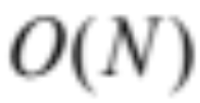
Nearest-Neighbor Method for Supervised Learning
Training Data
Output Register
(m qubits)
j
arg min dist(z,D_{j})
j
Classic:
Quantum:
Wiebe, Nathan, Ashish Kapoor, and Krysta Svore. "Quantum algorithms for nearest-neighbor methods for supervised and unsupervised learning." arXiv preprint arXiv:1401.2142 (2014).

Slide 32
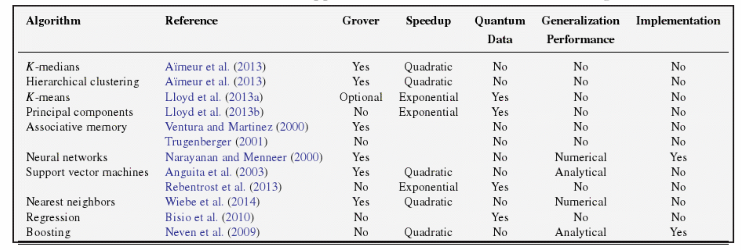
The Characteristics of the Main Approaches to Quantum Machine Learning
Table is from: Quantum Machine Learning : What Quantum Computing Means to Data Mining, Wittek, Peter, Elsevier Science & Technology, 2014.

Slide 33
(Unsupervised) Machine Learning
Model-Based Learning
K-means, K-medians,…
Picture from: Tibshirani, Robert, et al. "An introduction to statistical learning-with applications in R." (2013).
Notes:
Whenever AI system sees a new animal, it checks which side of the line this new data point is. The new animal in the picture is clearly a cat.

Slide 34
Quantum Basic Linear Algebra Subroutines (qBLAS) AKA HHL
Exponential speed up in Fourier transforms, finding eigenvectors and eigenvalues, solving linear equations,…
Useful in machine learning algorithms such as:
  Least-square fitting
  Gradient dissent
  Principal Component Analysis, Single Value Decomposition
  Support vector machines

Slide 35
Quantum Basic Linear Algebra Subroutines (qBLAS) AKA HHL
“Quantum state of n qubits is a vector in a 2^{n} dimensional complex vector space; performing a quantum logic operation or a measurement on qubits multiplies the corresponding state vector by 2^{n}×2^{n} matrices.”
“This performs common linear algebraic operations such as Fourier transforms, finding eigenvectors and eigenvalues solving linear sets of equations over 2^{n}-dimensional vector spaces in time that is polynomial in n, exponentially faster than their best known classical counterparts.”
Biamonte, Jacob, et al. "Quantum machine learning." Nature 549.7671 (2017): 195.

Slide 36
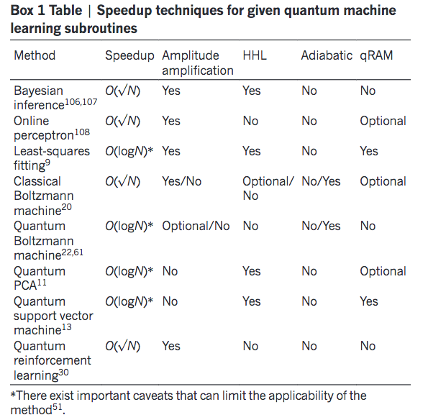
Quantum Basic Linear Algebra Subroutines (qBLAS) AKA HHL
Table from: Biamonte, Jacob, et al. "Quantum machine learning." Nature 549.7671 (2017): 195.

Slide 37
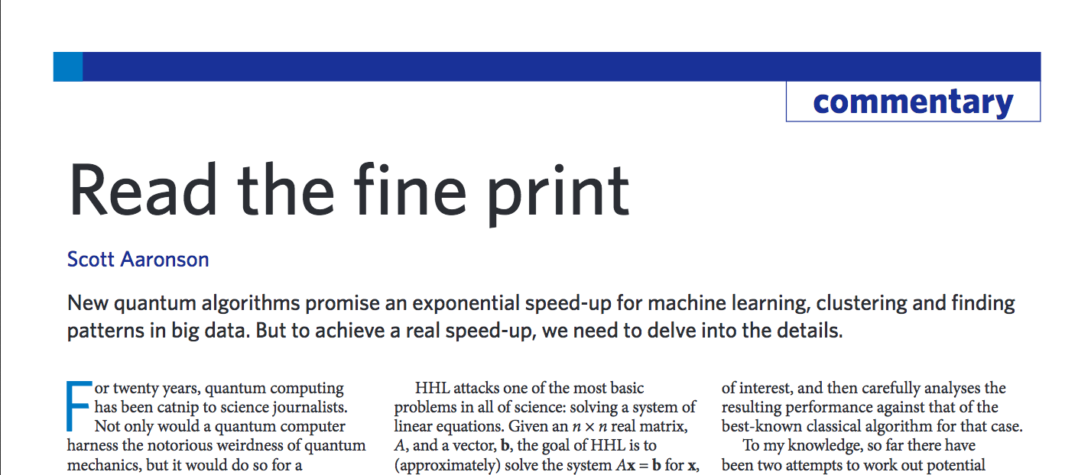
Quantum Basic Linear Algebra Subroutines (qBLAS) AKA HHL
Aaronson, Scott. "Read the fine print." Nature Physics 11.4 (2015): 291.
Table from: Biamonte, Jacob, et al. "Quantum machine learning." Nature 549.7671 (2017): 195.

Slide 38
qBLAS
Caveats
The input problem: Quantum algorithms provide dramatic speedups for processing data, they seldom provide advantages in reading data. The cost of reading in the input can dominate the cost of quantum algorithms. This cost can be exponential!
The output problem. Obtaining the full solution from some quantum algorithms as a string of bits requires learning an exponential number of bits.
Biamonte, Jacob, et al. "Quantum machine learning." Nature 549.7671 (2017): 195.

Slide 39
Machine Learning:
Compute Power, or Data Storage & Movement?

Slide 40
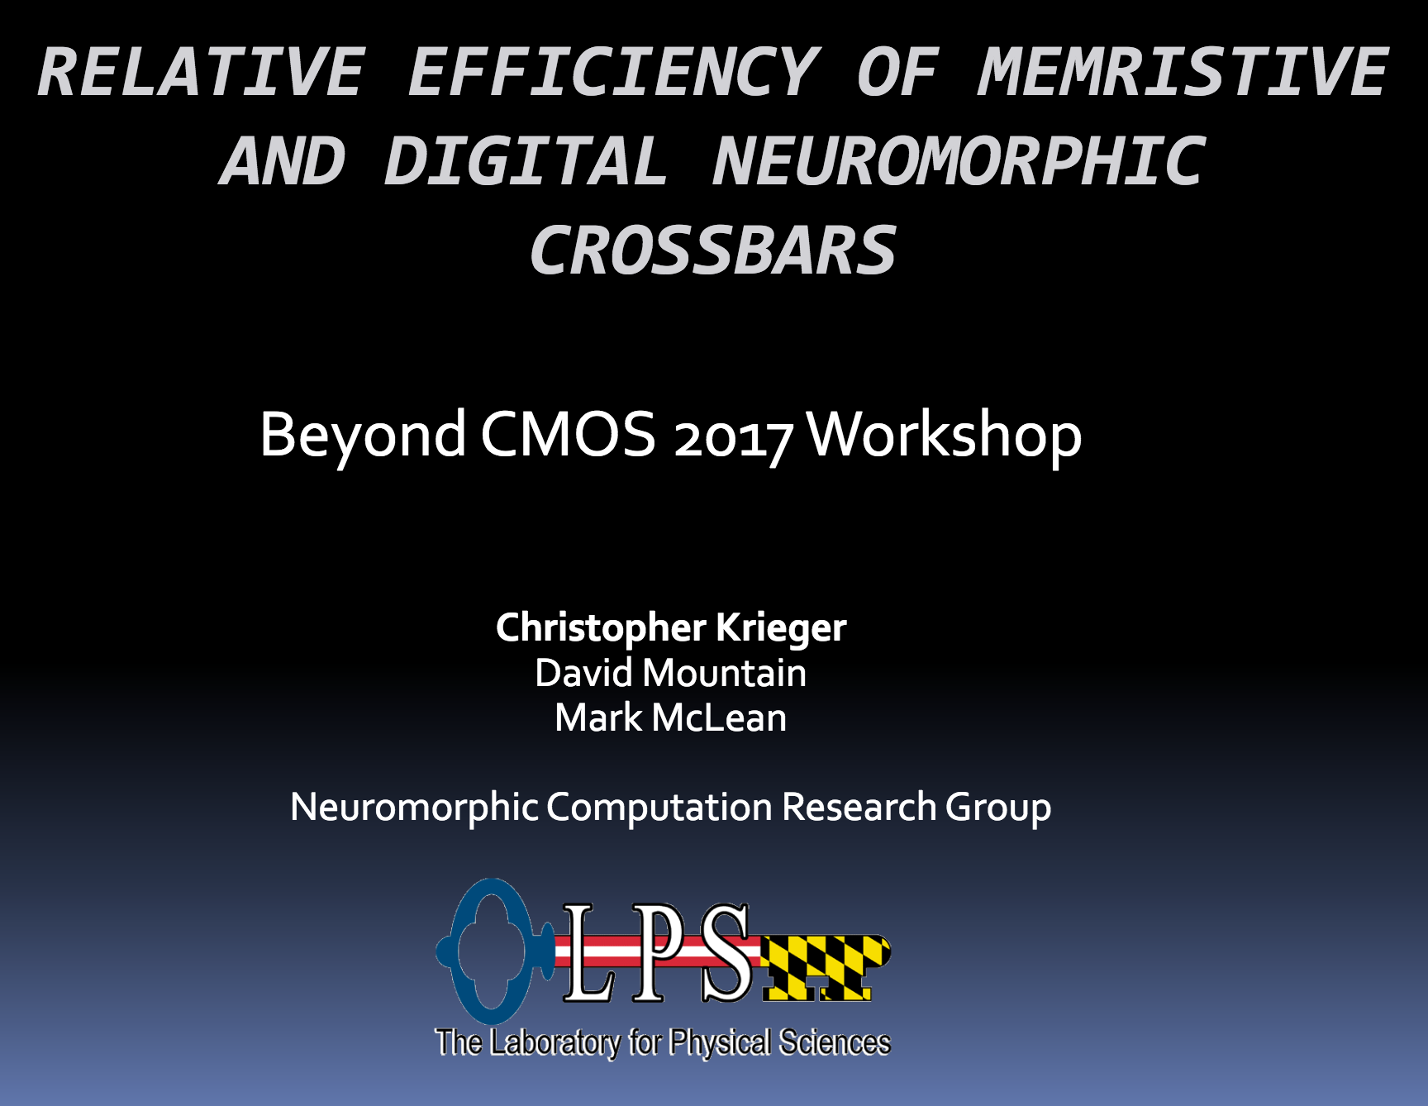
Compute Power, or Data Storage & Movement:
Which one is more important in Machine Learning?

Slide 41
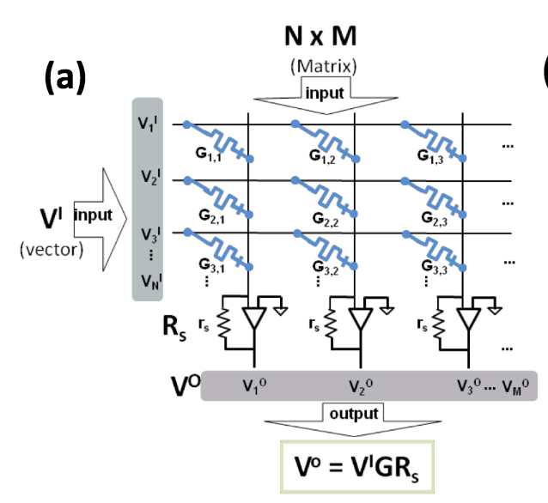
HP’s Dot-Product Engine for Neuromorphic Computing
Hu, M., Strachan, J. P., Li, Z., Grafals, E. M., Davila, N., Graves, C., ... & Williams, R. S. (2016, June). Dot-product engine for neuromorphic computing: programming 1T1M crossbar to accelerate matrix-vector multiplication. In Proceedings of the 53rd annual design automation conference (p. 19). ACM.

Slide 42
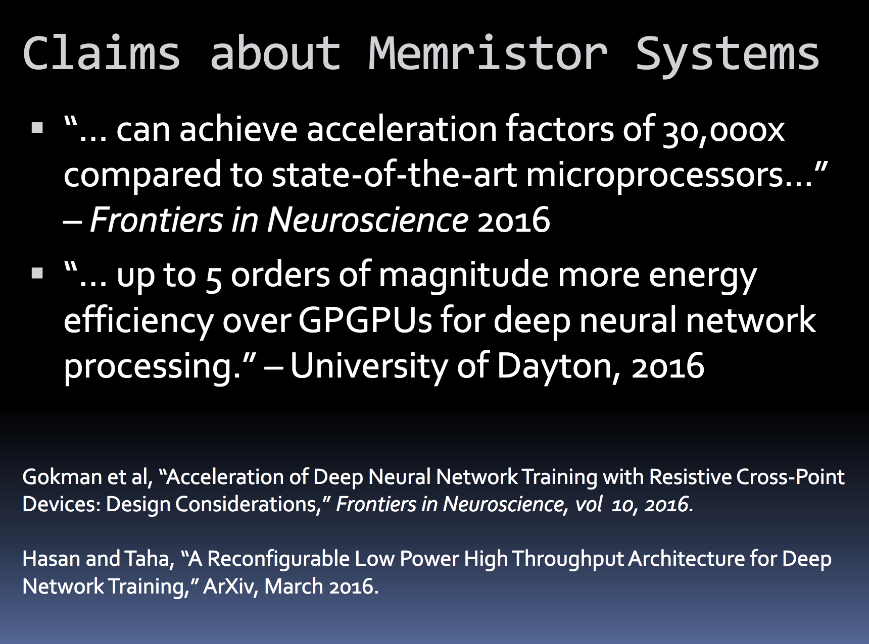
Compute Power, or Data Storage & Movement:
Which one is more important in Machine Learning?

Slide 43
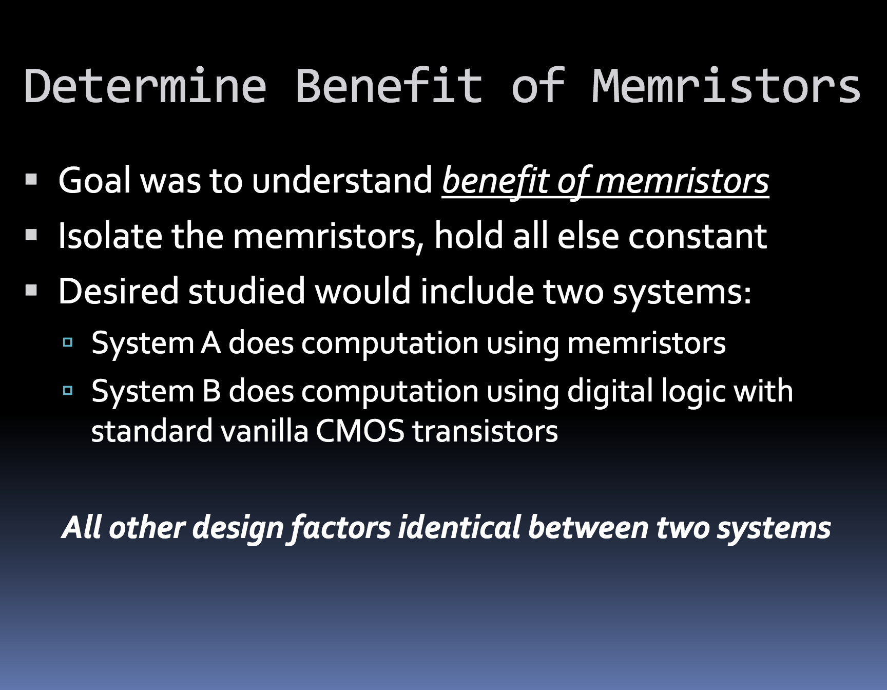
Compute Power, or Data Storage & Movement:
Which one is more important in Machine Learning?

Slide 44
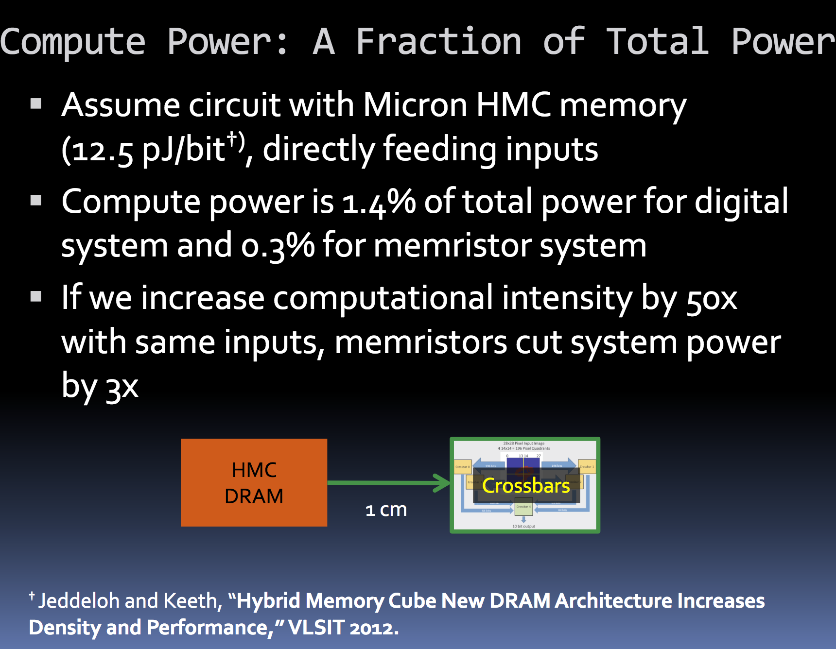
Compute Power, or Data Storage & Movement:
Which one is more important in Machine Learning?

Slide 45
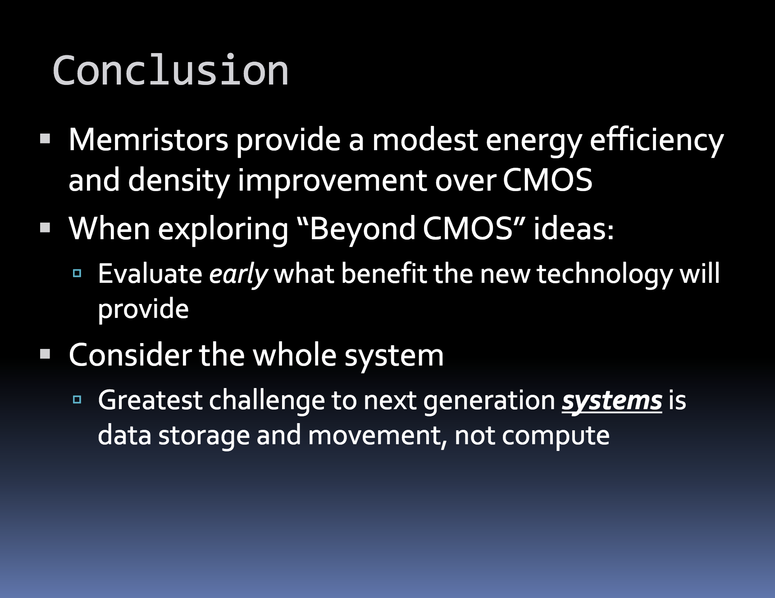
Compute Power, or Data Storage & Movement:
Which one is more important in Machine Learning?

Slide 46
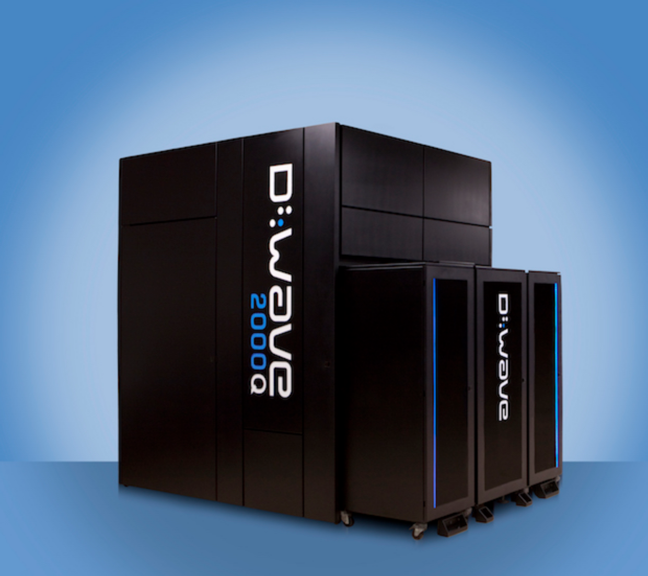

Slide 49
Adiabatic quantum computation (Quantum Annealing)

Slide 50

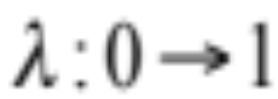
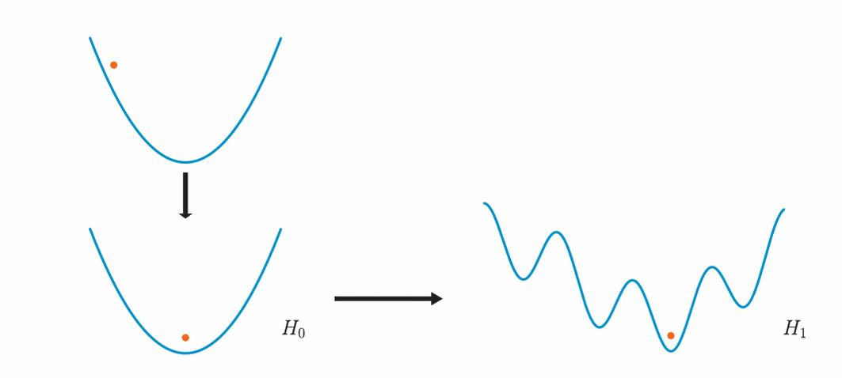
Adiabatic quantum computation (Quantum Annealing)
Picture is from: Quantum Machine Learning : What Quantum Computing Means to Data Mining, Wittek, Peter, Elsevier Science & Technology, 2014.

Slide 51
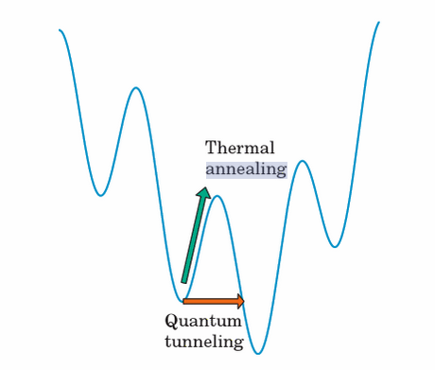
Adiabatic quantum computation (Quantum Annealing)

Slide 52
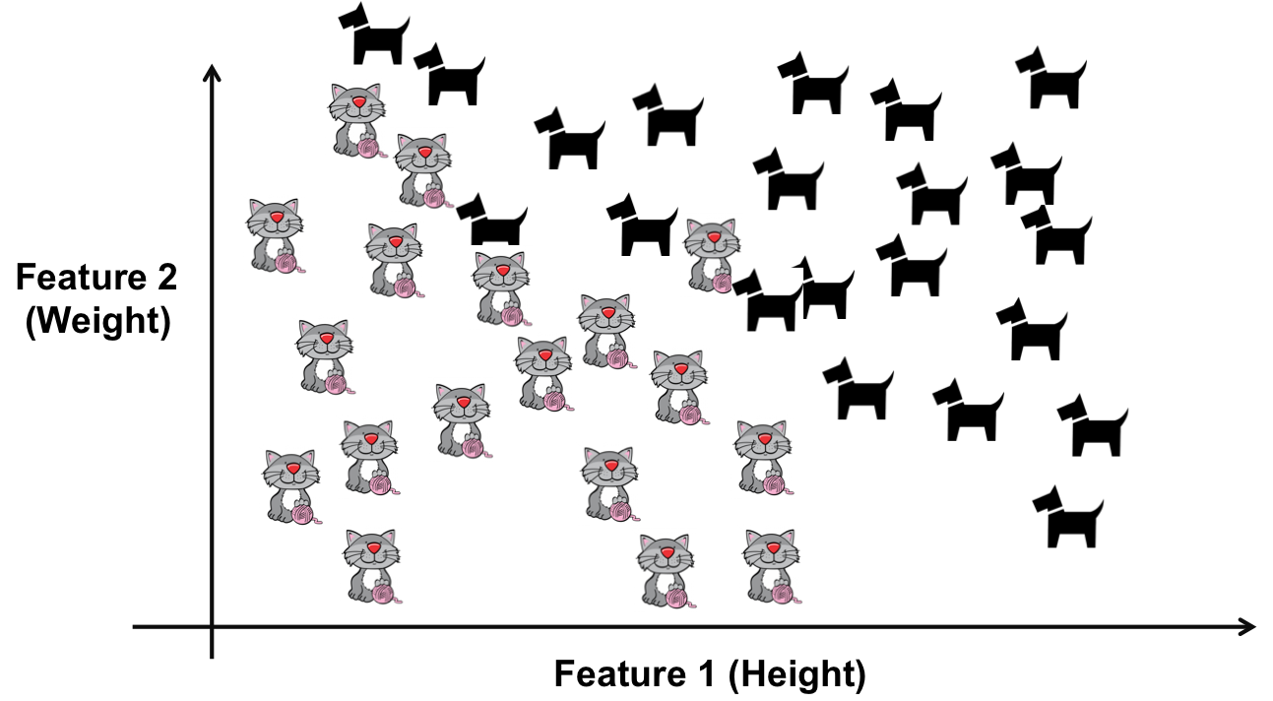
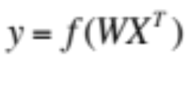
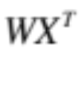
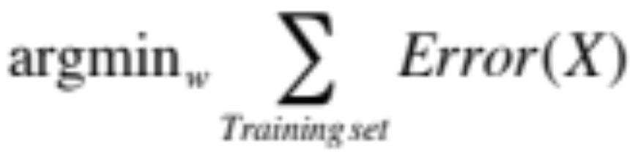
Optimization, an important ingredient of Machine Learning
Imagine W is the set of parameters of the model, and X is the features’ values, here weight and height.
A Model
WX^{T}=0
The goal is to find a set of parameters of the model, W, of which the error Error(X) is minimized over the training data.
Error(X) is the amount of misclassification.
Note that learning is not just optimizing a model to a training set. Overfitting does not result in generalization.
Notes:
The question is how should extract this model from the training data.
This is a parametric model. The goal is to estimate the parameters using the training data in order to fit the model to the training data (here separating dogs from cats). We can write down an Error function, which says how precise the model is in separating dogs from the cats. Error can be the number of misclassified dogs and cats. So now we have to minimize this Error function by selecting proper parameters. This is now an optimization problem. This can be done in different ways.
1- In simple systems, we can analytically solve it and find the parameter values that minimizes the error.
2- In more complex systems that we cannot analytically solve, we have to rely on heuristic methods to find a solution that is good enough.

Slide 53
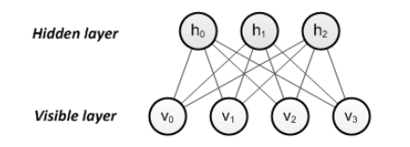

Optimization, an important ingredient of Machine Learning
We usually don’t have error function or the energy function in a closed form.
But there are exceptions:
Example: Training Deep belief networks (Restricted Boltzmann Machines)
Adachi, Steven H., and Maxwell P. Henderson. "Application of quantum annealing to training of deep neural networks." arXiv preprint arXiv:1510.06356 (2015).
Notes:
The question is how should extract this model from the training data.
This is a parametric model. The goal is to estimate the parameters using the training data in order to fit the model to the training data (here separating dogs from cats). We can write down an Error function, which says how precise the model is in separating dogs from the cats. Error can be the number of misclassified dogs and cats. So now we have to minimize this Error function by selecting proper parameters. This is now an optimization problem. This can be done in different ways.
1- In simple systems, we can analytically solve it and find the parameter values that minimizes the error.
2- In more complex systems that we cannot analytically solve, we have to rely on heuristic methods to find a solution that is good enough.

Slide 54
Final notes
A quantum learner is not more powerful than a classical learner. But quantum computing can be considered as an accelerator to speed up learning.
Quantum computers cannot solve machine learning’s NP-hard problems in polynomial time.
Servedio, Rocco A., and Steven J. Gortler. "Equivalences and separations between quantum and classical learnability." SIAM Journal on Computing 33.5 (2004): 1067-1092.
Bennett, Charles H., et al. "Strengths and weaknesses of quantum computing." SIAM journal on Computing 26.5 (1997): 1510-1523.

Slide 55
Final Notes
Quantum machine learning is not going to solve all problems of machine learning.
There are specific limitations that come with quantum machine learning. However, it can be useful in specific tasks.
There are multiple technical and theoretical challenges in front of quantum machine learning.
We need multiple breakthrough innovations in order to achieve quantum machine learning. qRAM seems to be the main one.

Slide 56
Final Notes
We have to consider and investigate the performance of the entirety of the learning system instead of arbitrary portions that fit our solution better.

Slide 57
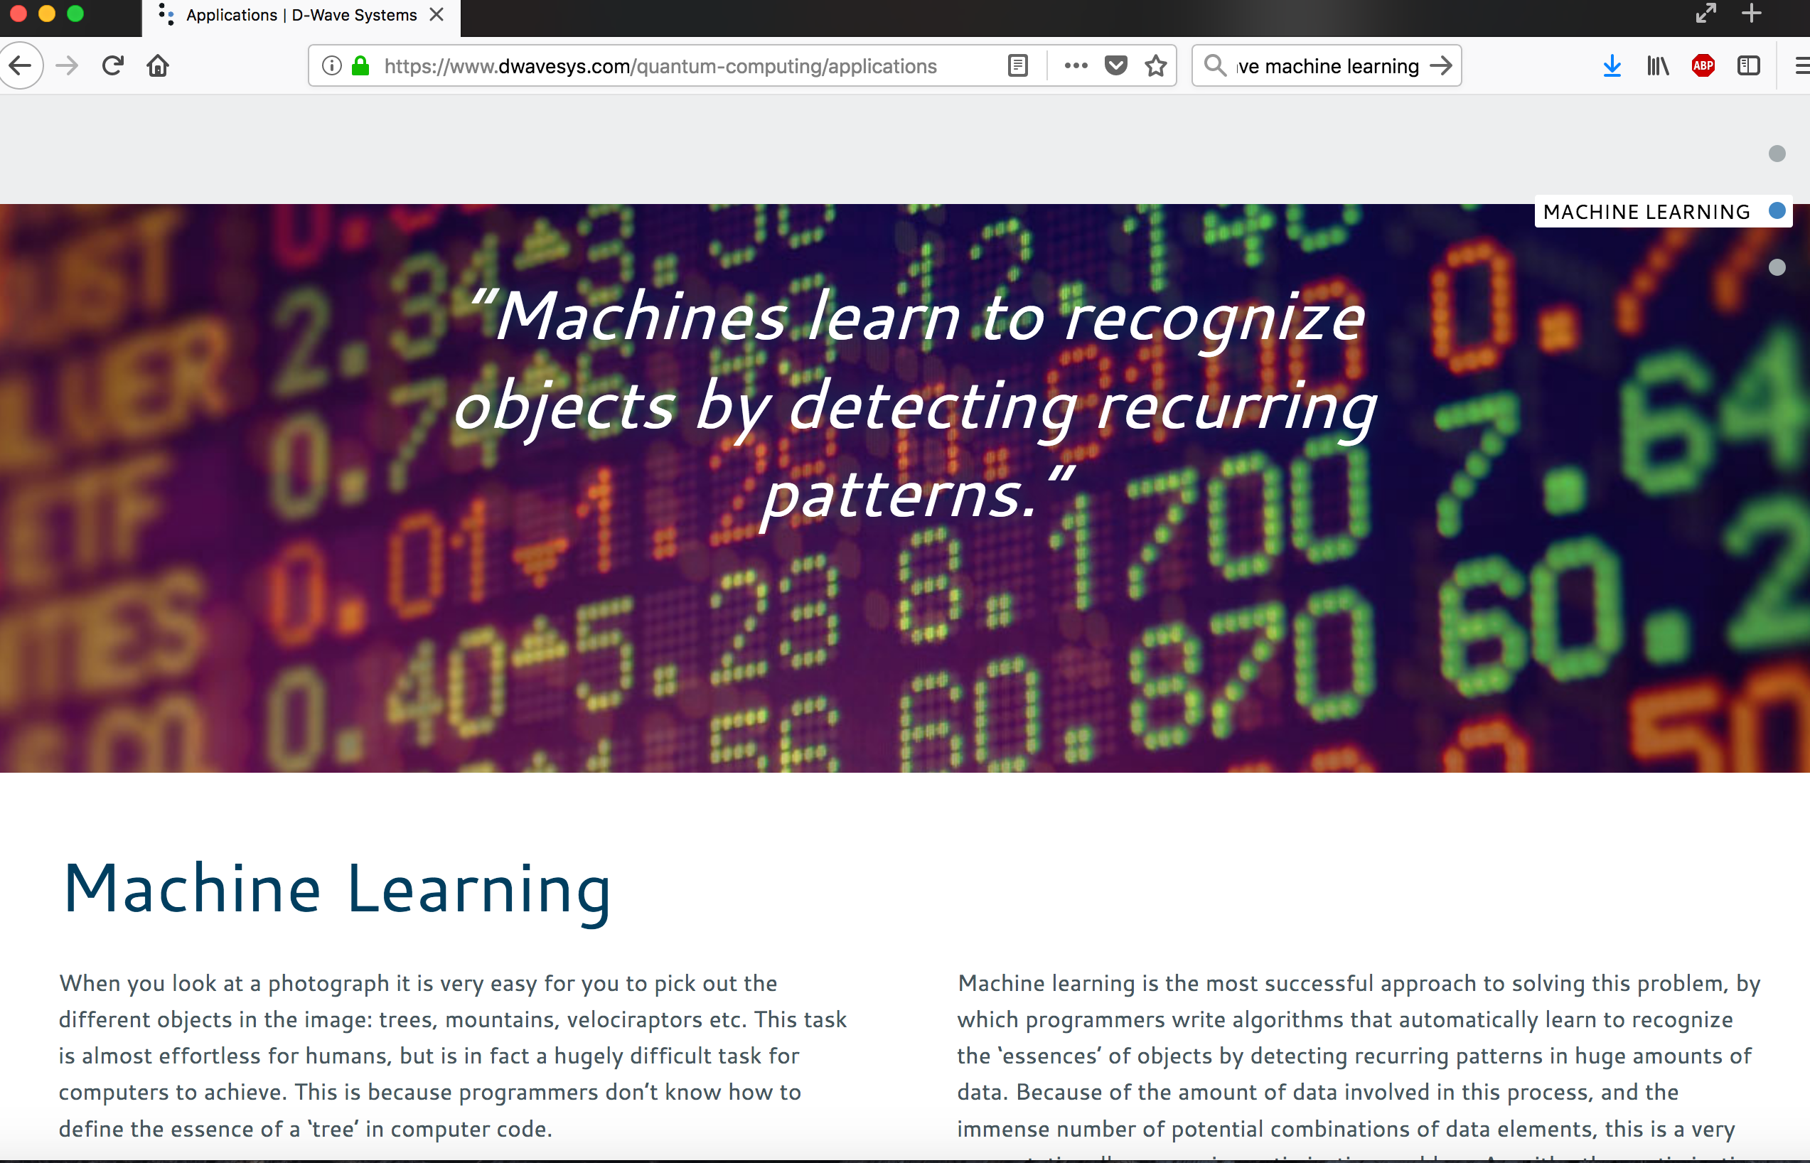

Slide 58
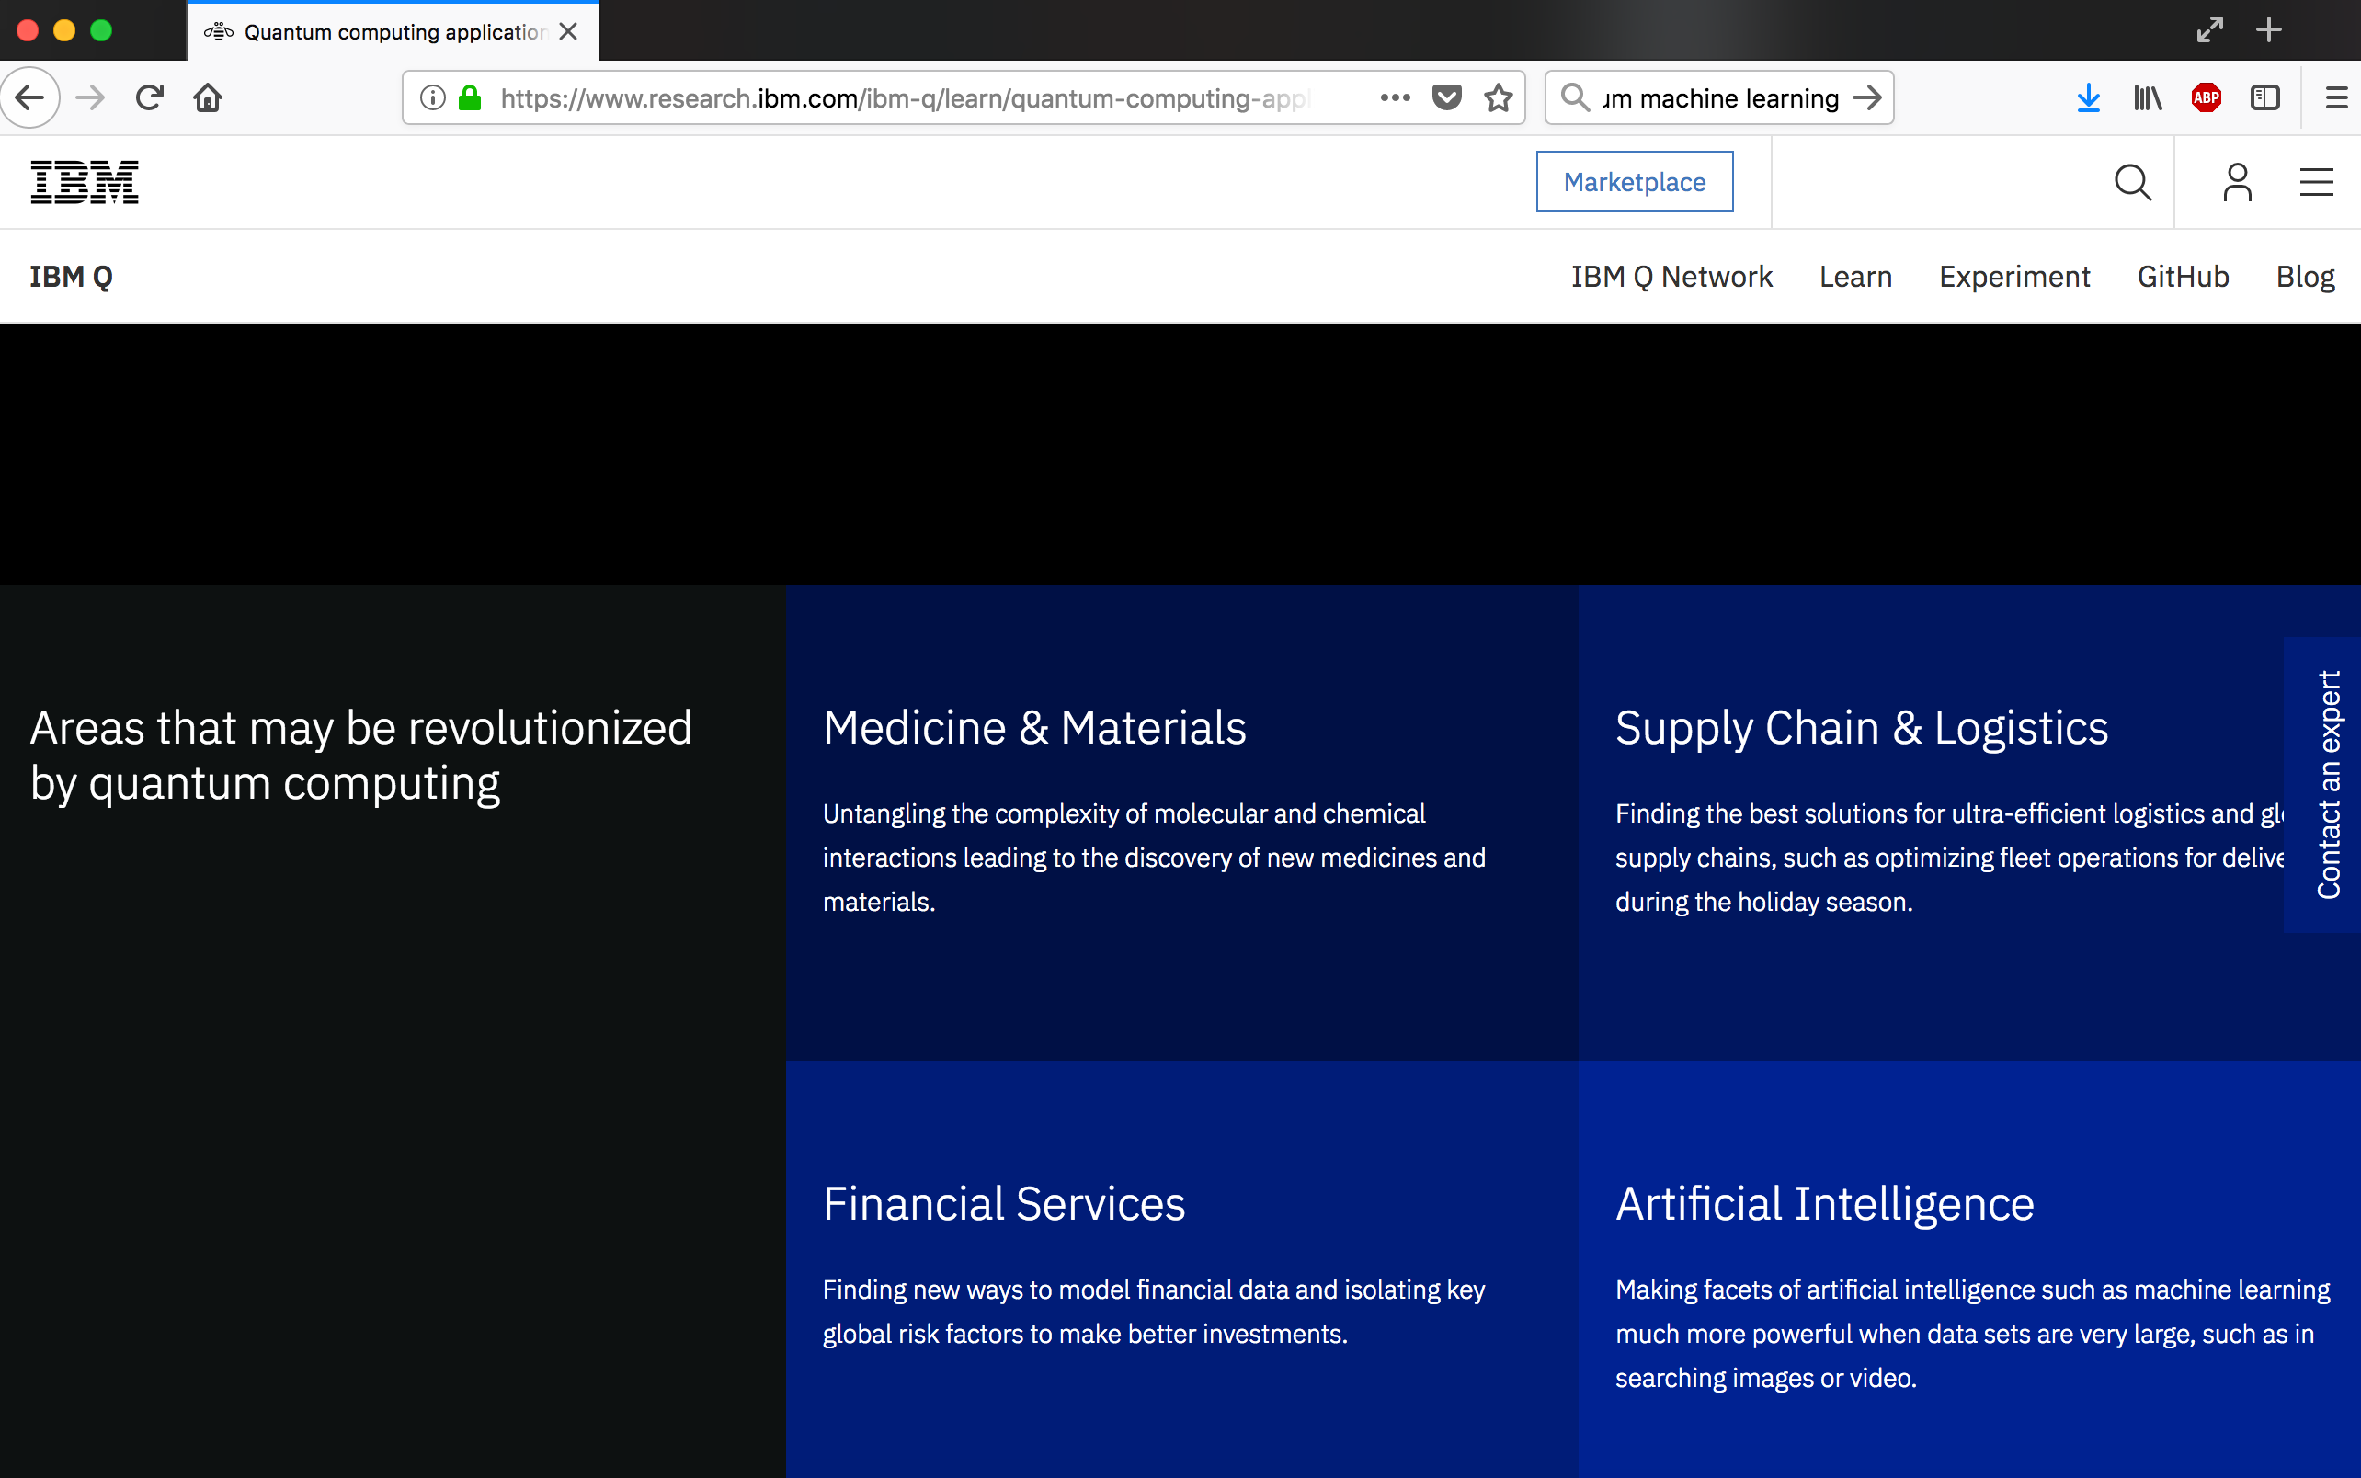

Slide 59
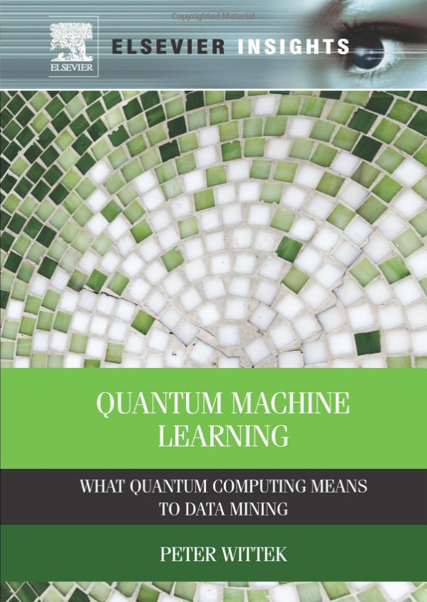
A good resource
Available as an EBook through NCSU’s ligrary

