Slide 1
Quantum Information Theory Introduction
Abida Haque
ahaque3@ncsu.edu

Slide 2
Outline
Motivation
Mixed States
Classical Information Theory
Quantum Information Theory

Slide 3
Motivation
How many bits are in a qubit?
If we have a random variable X distributed according to some probability distribution P, how much information do you learn from seeing X?

Slide 4









Sending Information
Alice wants to send Bob a string x.
Classically:

Slide 5





Sending Information
Quantumly:
Alice does a computation to create the state.
Can only discriminate quantum states if they are orthogonal.
But more generally…

Slide 6



Mixed States
Using vectors for a quantum system is not enough
Model quantum noise for when you implement a quantum system
Eg, the device outputs

Slide 7






















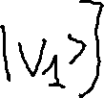





Mixed States
Basis:
Represent by:

Slide 8


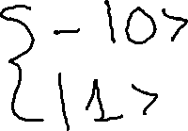








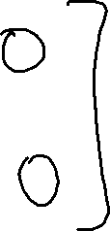










Examples
Notes:
Note: these are indistinguishable for an observer.

Slide 9









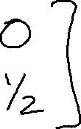





Examples II

Slide 10
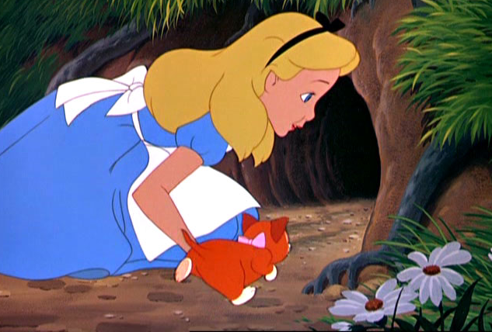

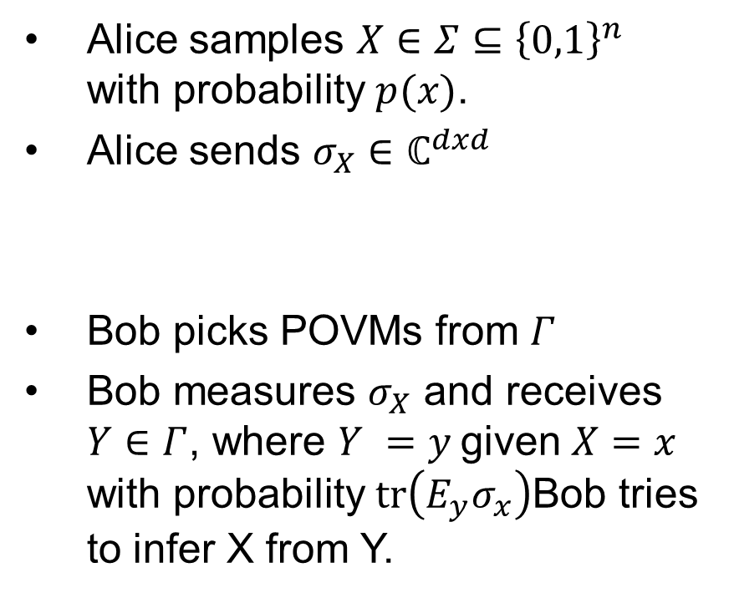
More general scenario
Alice samples $X∈Σ⊆{\left\{0,1\right\}}^{n}$ with probability $p(x)$.
Alice sends $σ_{X}∈ℂ^{dxd}$
Bob picks POVMs from $Γ$
Bob measures $σ_{X}$ and receives $Y∈Γ$, where $Y =y$given $X=x$ with probability $\operatorname{tr}\left(E_{y}σ_{x}\right)$Bob tries to infer X from Y.
Notes:
POVM: positive-operator valued measure is a set of positivesemidefinite matrices. Specifyingr Gives a way for Bob to do measurement.

Slide 11









More general scenario

Slide 12




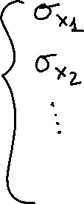







Perspectives
Bob sees
Alice sees

Slide 13
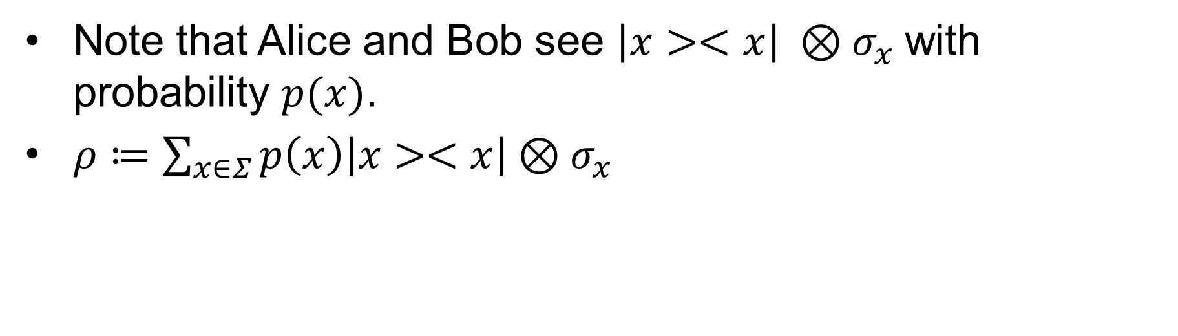
Joint Mixed System
Note that Alice and Bob see $\left|x><x\right| ⊗σ_{x}$with probability $p(x)$.
$ρ≔\sum_{x∈Σ}{p\left(x\right)\left|x><x\right|}⊗σ_{x}$

Slide 14
Classical Information Theory
Alice samples a random message X with probability P(X).
How much information can Bob learn about X?

Slide 15
Examples
If P is the uniform distribution, then Bob gets n bits of info from seeing X.
If P has all its probability on a single string, Bob gets 0 bits of information seeing X.

Slide 16
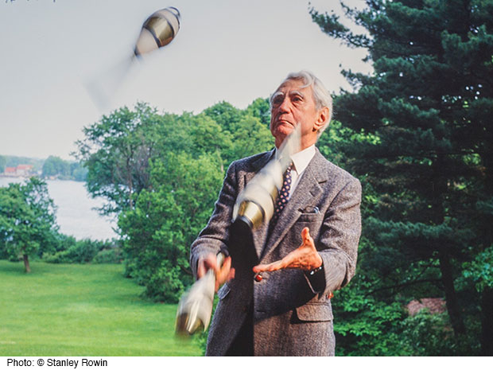
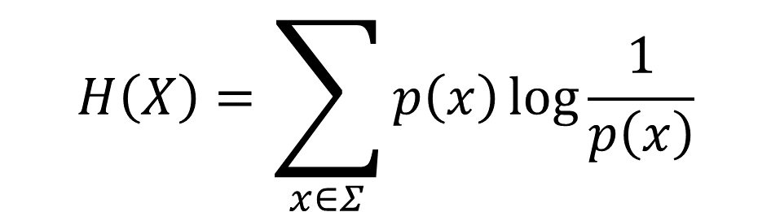
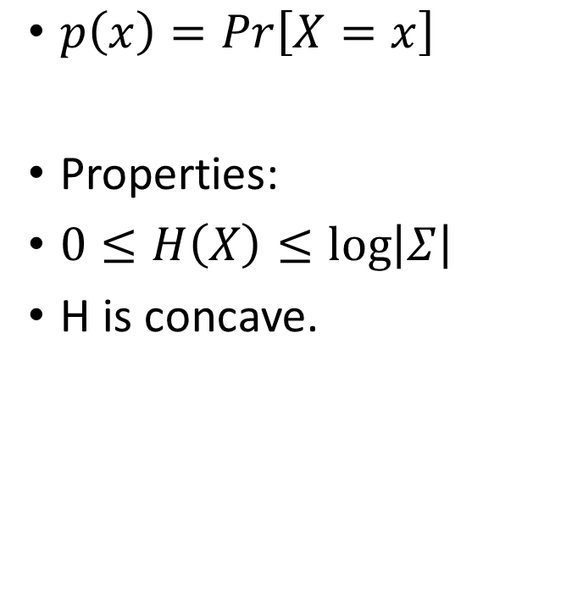
Shannon Entropy
$p\left(x\right)=Pr\left[X=x\right]$
Properties:
$0≤H\left(X\right)≤\log\left|Σ\right|$
H is concave.
$$H\left(X\right)=\sum_{x∈Σ}{p\left(x\right)\log{\frac{1}{p\left(x\right)}}}$$
Claude Shannon

Slide 17












Examples
X is uniformly distributed

Slide 18










Examples II
X has all its probability mass on a single string.

Slide 19
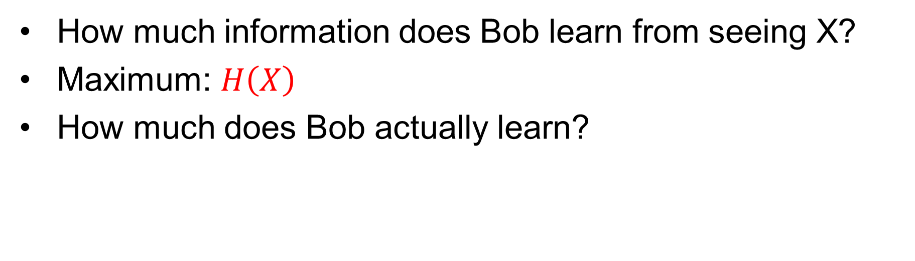
Classical Information Theory
How much information does Bob learn from seeing X?
Maximum: $H\left(X\right)$
How much does Bob actually learn?

Slide 20
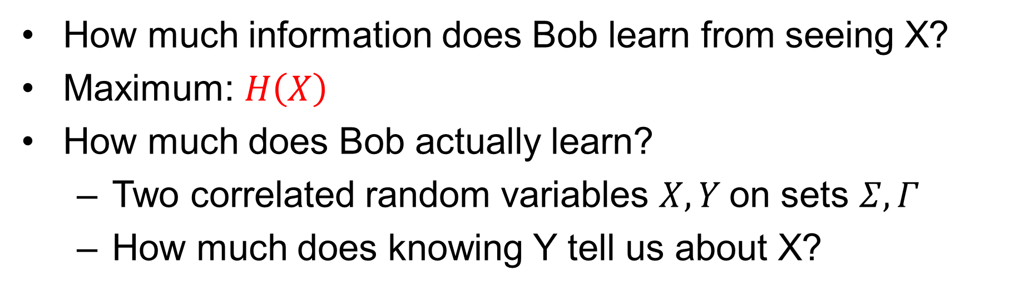
Classical Information Theory
How much information does Bob learn from seeing X?
Maximum: $H\left(X\right)$
How much does Bob actually learn?
  Two correlated random variables $X, Y$on sets $Σ,Γ$
  How much does knowing Y tell us about X?

Slide 21
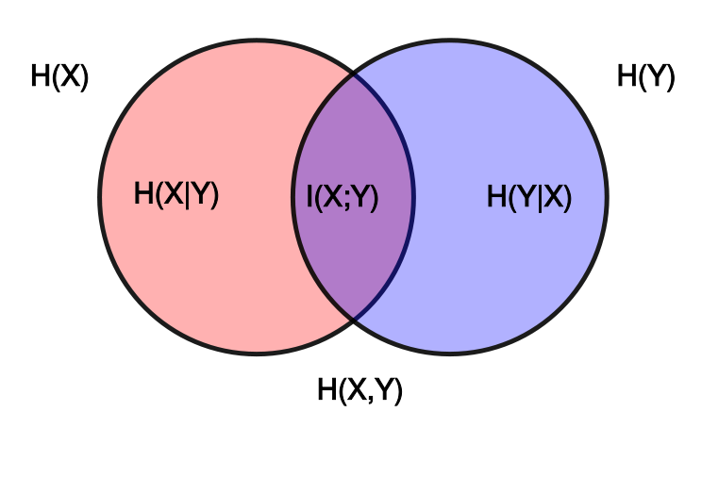
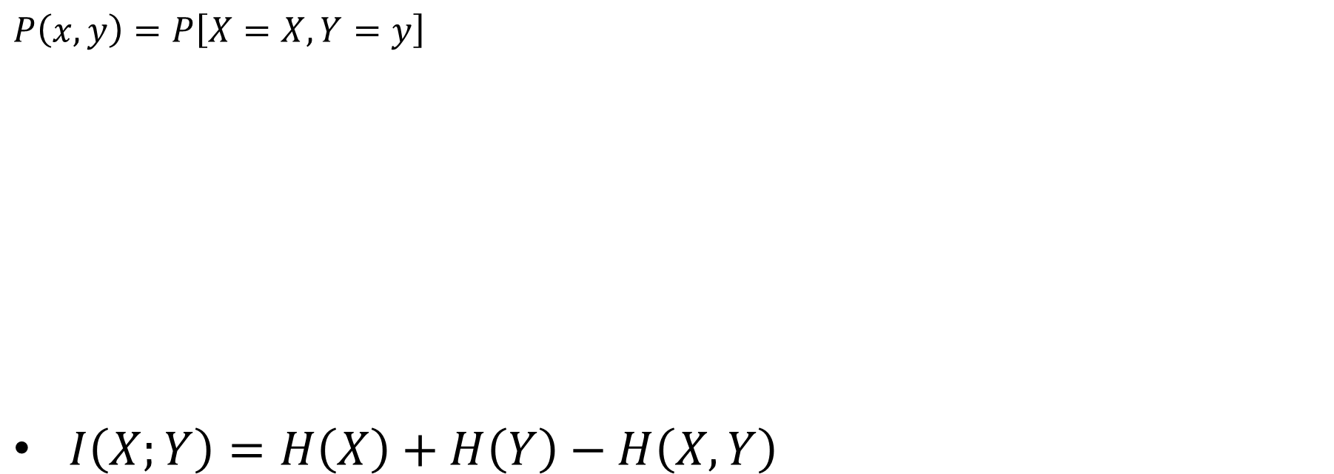
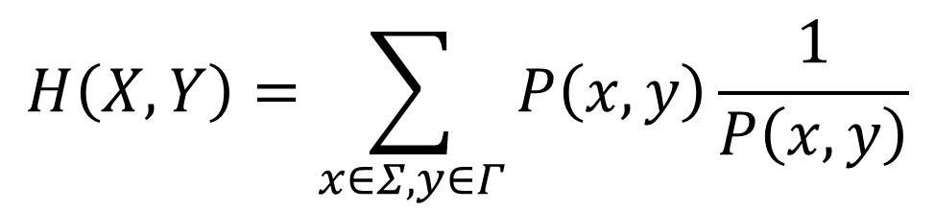
Joint Distribution, Mutual Information
$$P\left(x,y\right)=P\left[X=X,Y=y\right]$$
$I\left(X;Y\right)=H\left(X\right)+H\left(Y\right)−H\left(X,Y\right)$
$$H\left(X,Y\right)=\sum_{x∈Σ,y∈Γ}{P\left(x,y\right)\frac{1}{P\left(x,y\right)}}$$
The more different the distributions for P(x) and P(y) are on average, the greater the information gain.

Slide 22














Examples
If X and Y are independent then:
If X and Y are perfectly correlated:

Slide 23













Analog of Shannon’s

Slide 24










Indistinguishable States
What if you see…
Then…

Slide 25
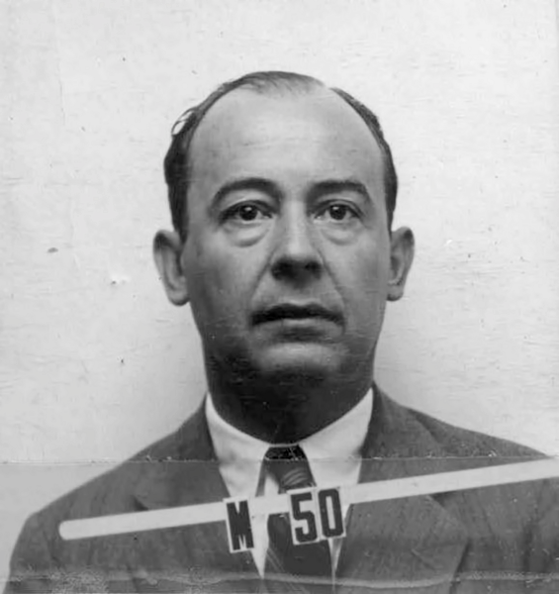
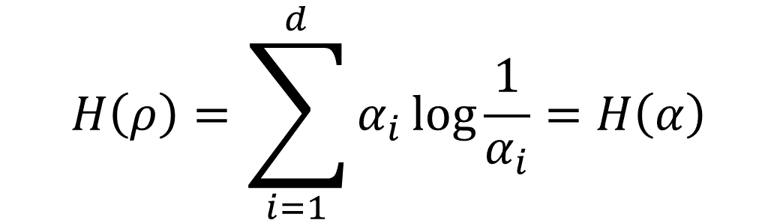
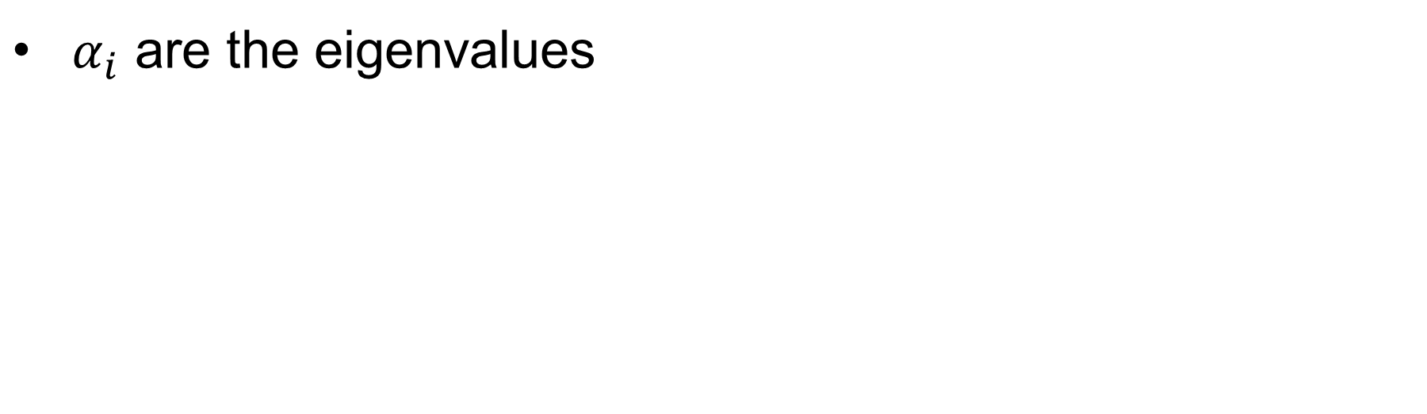
Von Neumann Entropy
$$H\left(ρ\right)=\sum_{i=1}^{d}{α_{i}\log{\frac{1}{α_{i}}}}=H\left(α\right)$$
$α_{i}$ are the eigenvalues
John von Neumann

Slide 26
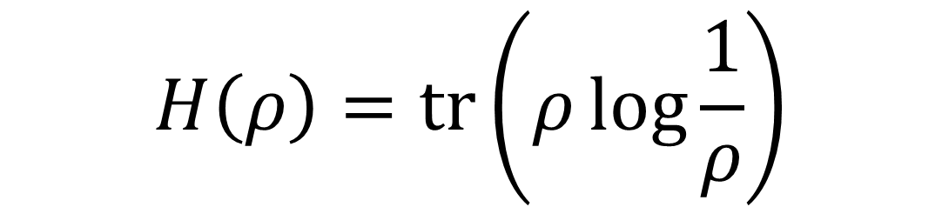
Von Neumann Entropy
Equivalently:
$$H\left(ρ\right)=\operatorname{tr}\left(ρ\log{\frac{1}{ρ}}\right)$$

Slide 27

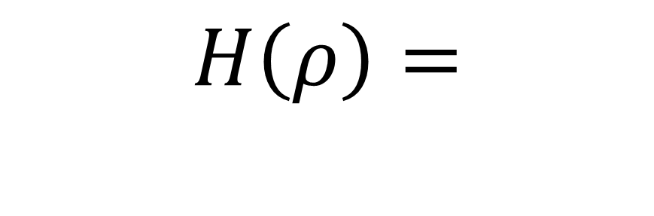
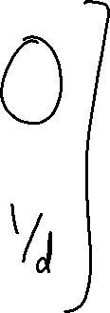





Example
“Maximally mixed state”
$$H\left(ρ\right)=$$
$$ρ=$$

Slide 28
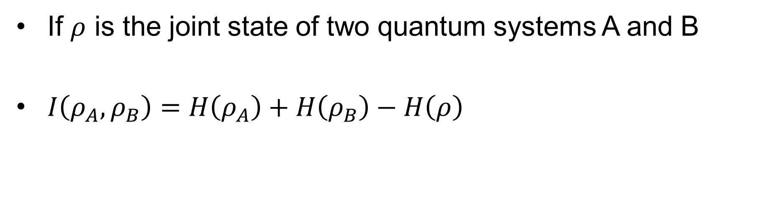
Quantum Mutual Information
If $ρ$ is the joint state of two quantum systems A and B
$I\left(ρ_{A},ρ_{B}\right)=H\left(ρ_{A}\right)+H\left(ρ_{B}\right)−H\left(ρ\right)$

Slide 29
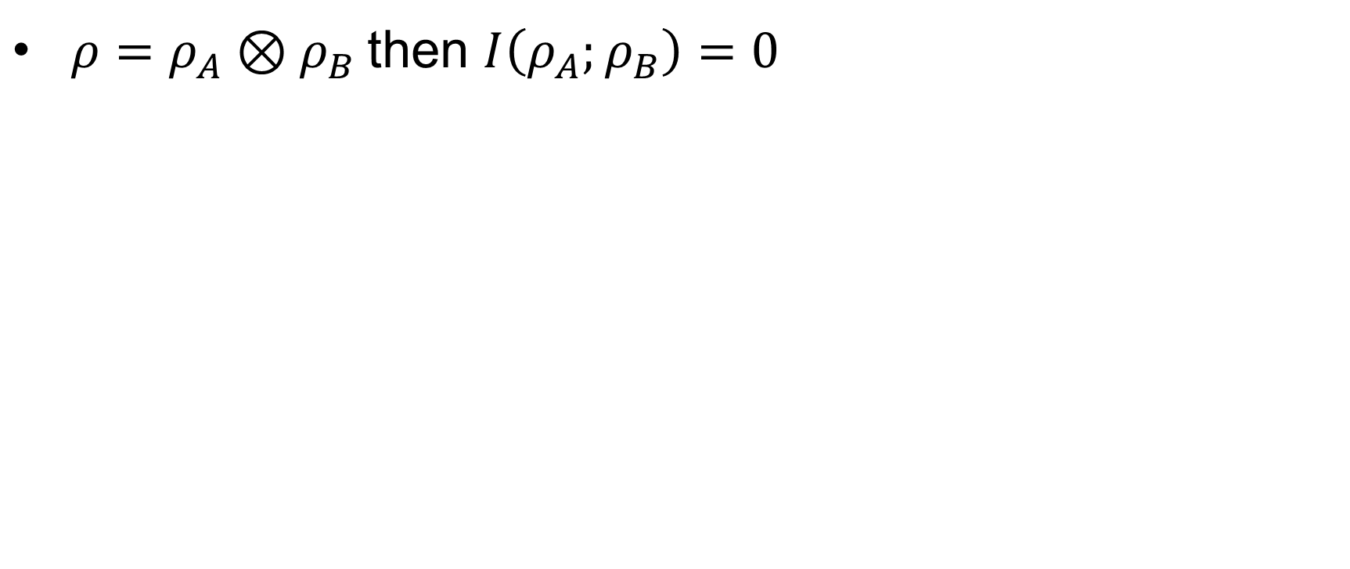
Example
$ρ=ρ_{A}⊗ρ_{B}$then $I\left(ρ_{A};ρ_{B}\right)=0$

Slide 30
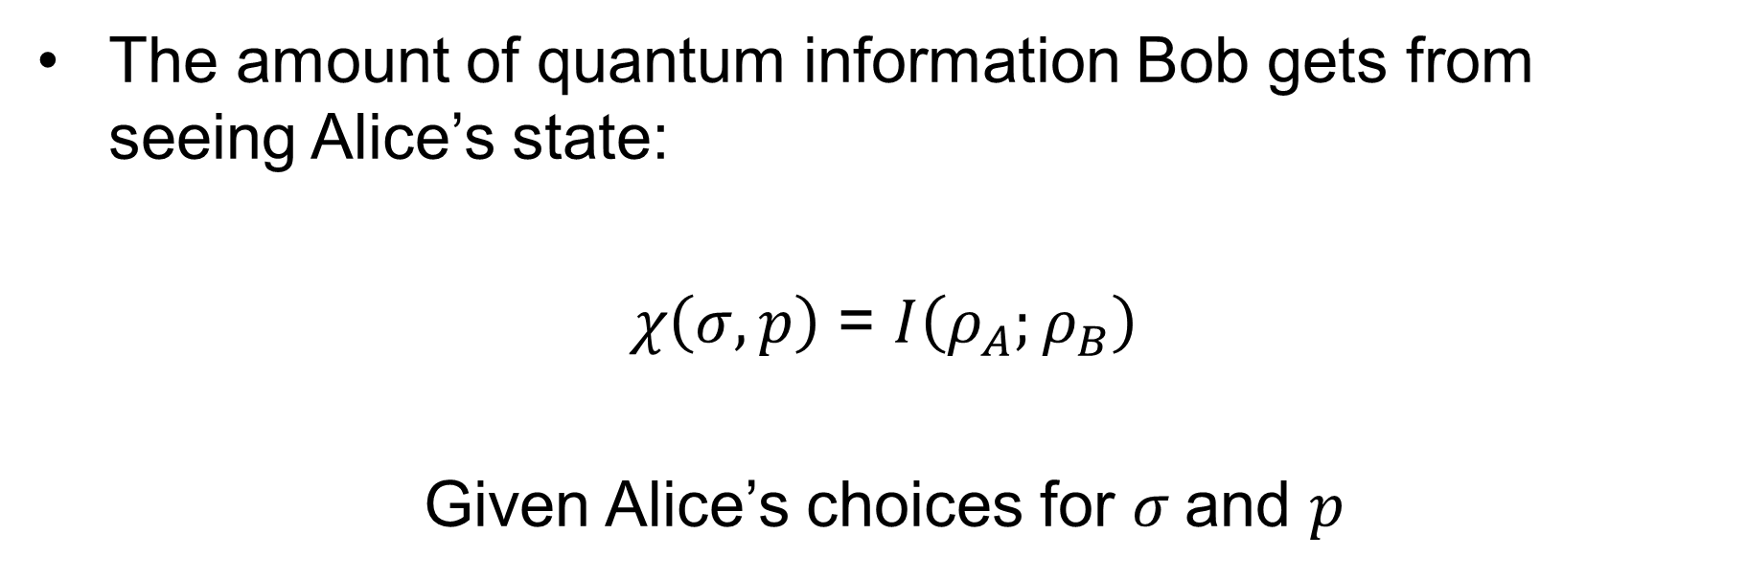
Holevo Information
The amount of quantum information Bob gets from seeing Alice’s state:
$χ\left(σ,p\right)$ = $I\left(ρ_{A};ρ_{B}\right)$
Given Alice’s choices for $σ$and $p$

Slide 31
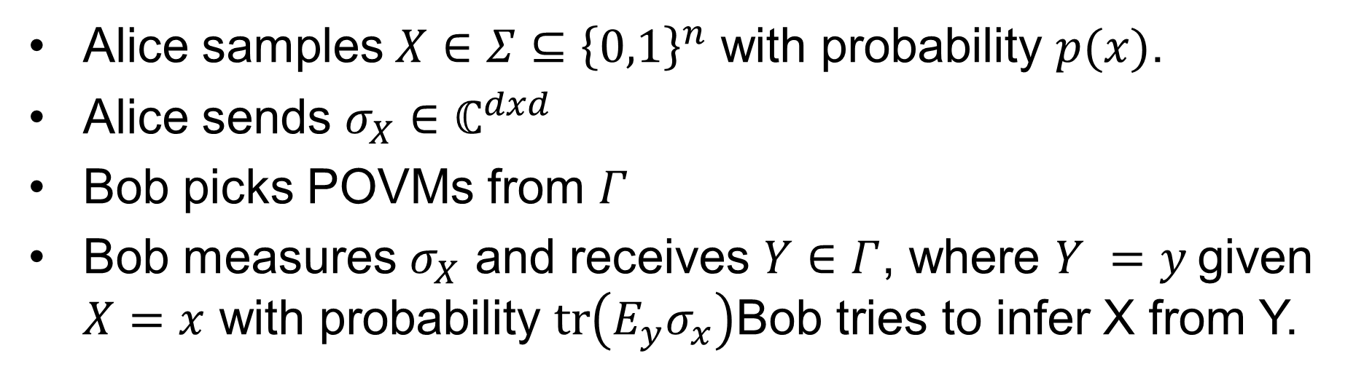


Recall
Alice samples $X∈Σ⊆{\left\{0,1\right\}}^{n}$ with probability $p(x)$.
Alice sends $σ_{X}∈ℂ^{dxd}$
Bob picks POVMs from $Γ$
Bob measures $σ_{X}$ and receives $Y∈Γ$, where $Y =y$given $X=x$ with probability $\operatorname{tr}\left(E_{y}σ_{x}\right)$Bob tries to infer X from Y.

Slide 32






Holevo’s Bound
n qubits can represent no more than n classical bits.
Holevo’s bound proves that Bob can retrieve no more than n classical bits.
Odd because it seems like quantum computing should be more powerful than classical.
Assuming Alice and Bob do not share entangled qubits.
Alexander Holevo
Notes:
And it takes $2^{n}−1$ complex numbers to represent n classical bits.

Slide 33
Thank You!
Abida Haque
ahaque3@ncsu.edu

